Slide 1
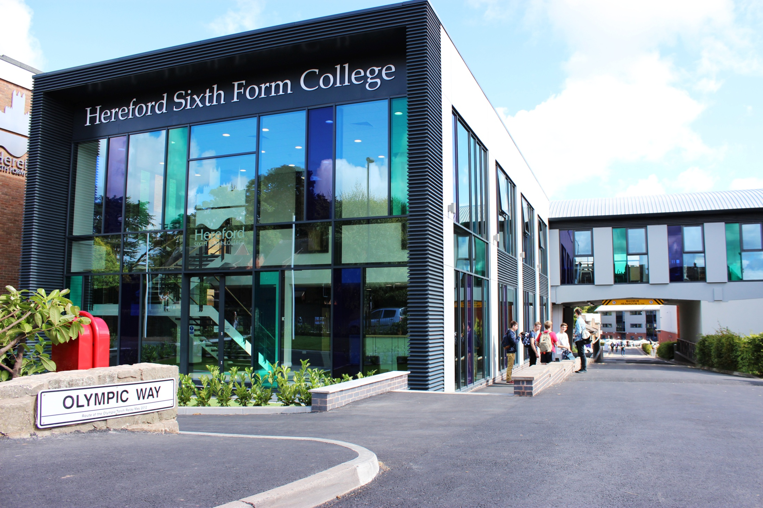

INFORMATION EVENING FOR PARENTS OF NEW STUDENTS
September 2024
HEREFORD SIXTH FORM COLLEGE IS AS GOOD AS IT GETS IN THE STATE SECTOR FOR SIXTH FORM EDUCATION, IT GIVES INDEPENDENT SCHOOLS A TERRIFIC RUN FOR THEIR MONEY. - THE GOOD SCHOOLS GUIDE

Slide 2
Who is with you tonight?
Catherine Brearey Principal
Phil Tranter
Deputy Principal
Sophie Wheadon
Senior Vocational Curriculum Lead

Slide 3

What do we want from our student’s time with us?
Course success on the correct course
Give their maximum effort in all things
Get physically and mentally active - Impact!
Meet new friends
Help, respect and support each other
Enjoy their time

Slide 4
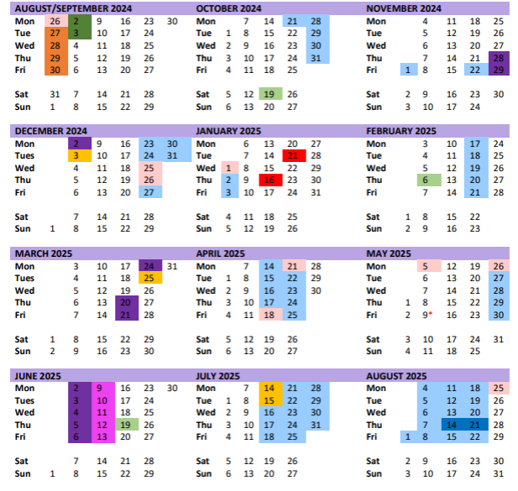
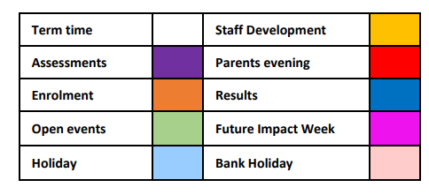
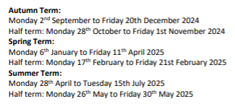
Overview of the year

Slide 5
Date
31st March – deadline for internal and external access arrangements

Slide 6


Slide 7

Expectation of student’s hours

Slide 8

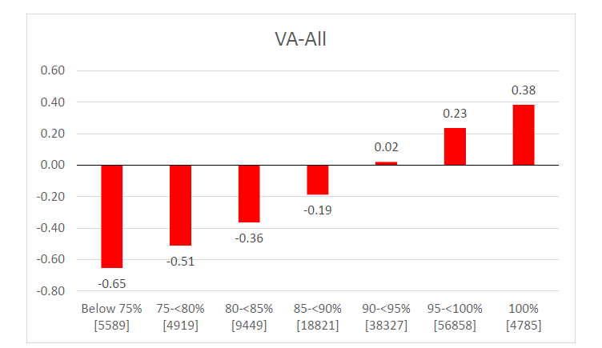

Slide 9
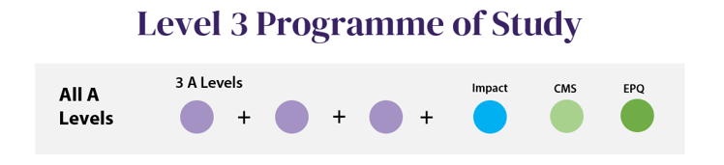
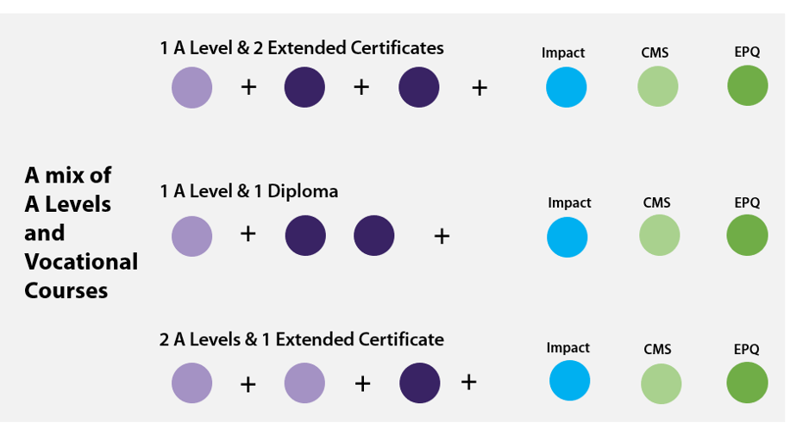
What will their programme of study look like?

Slide 10

How are the workshops used?
4hrs 20 mins per subject
Up to 1hr 20 mins per subject directed time
Up to 5 hrs per subject homework
Workshops for help - available in all subjects but students will need to select and write these on their timetables to suit
Compulsory workshops - where remedial work needs to be completed

Slide 11
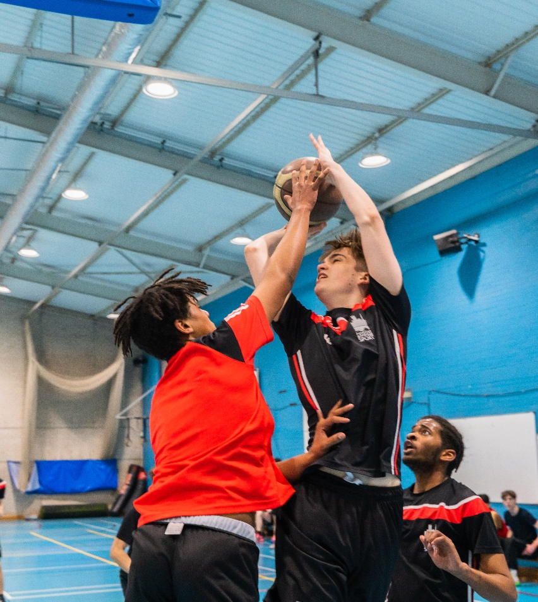
We will set them realistic targets
Attendance
Target Grade
- Based on average GCSE score
- Varies from subject to subject

Slide 12
Minimum Target Grade
(A)
(C)
(E)
Average A Level Grade
(4) (5) (6) (7) (8) (9)
Average GCSE Grade

Slide 13
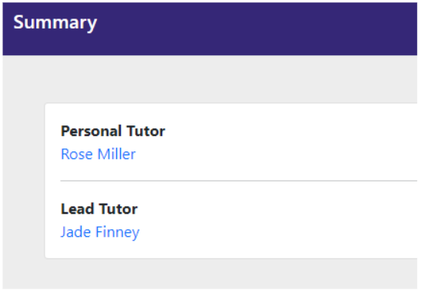
Parent Portal
Tutor contacts

Slide 14
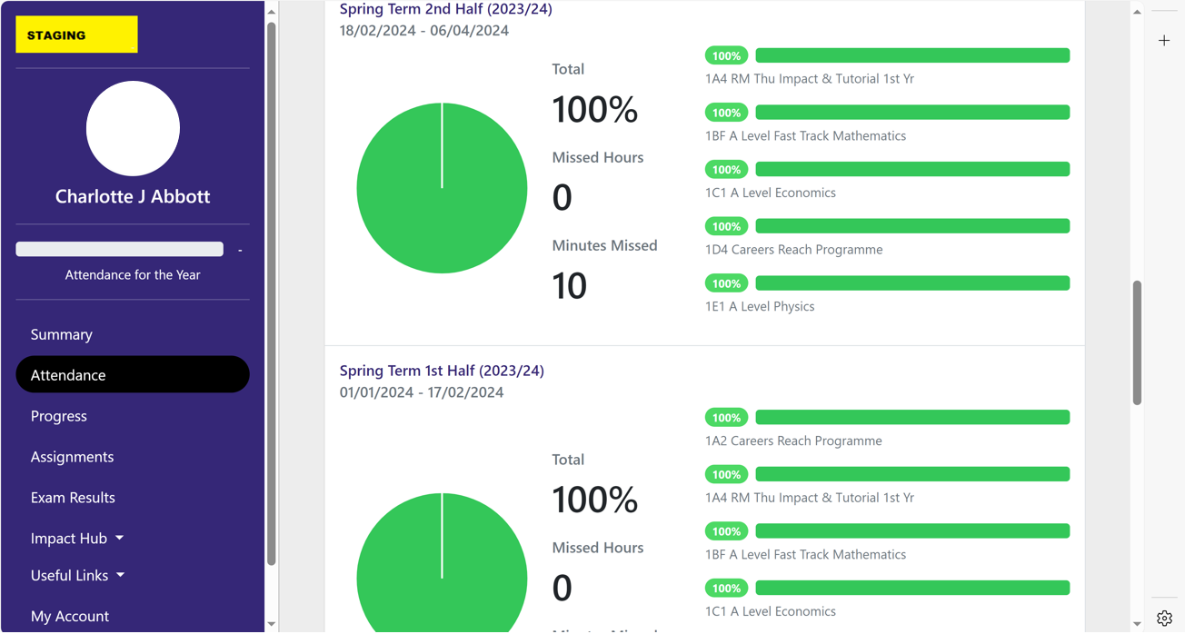
Attendance

Slide 15
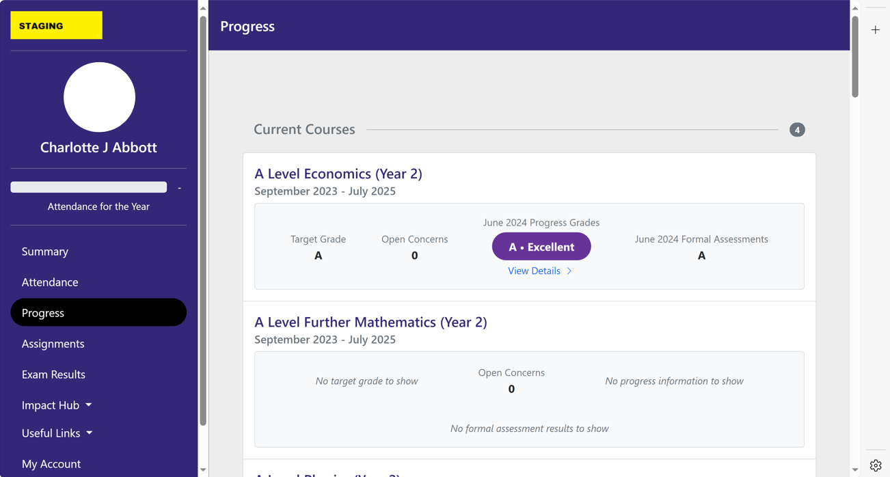
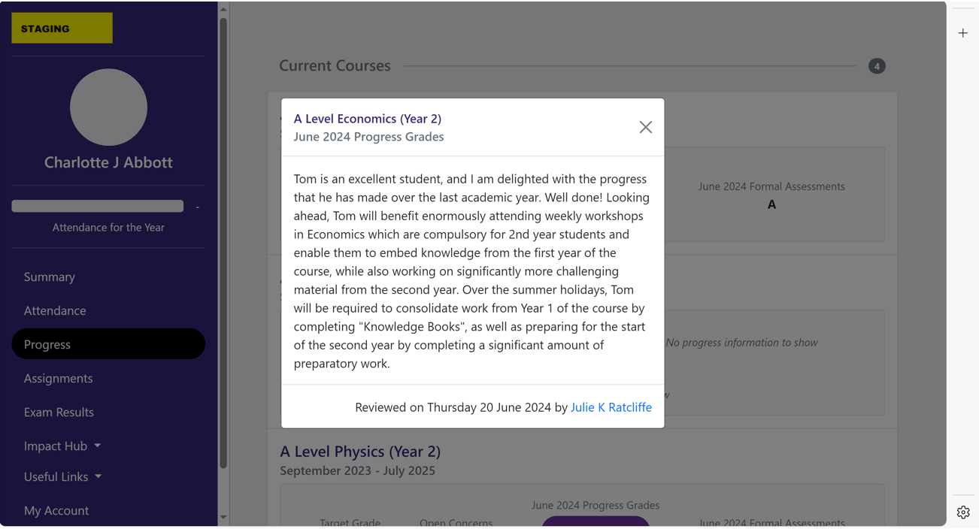
Progress
Progress Report

Slide 16
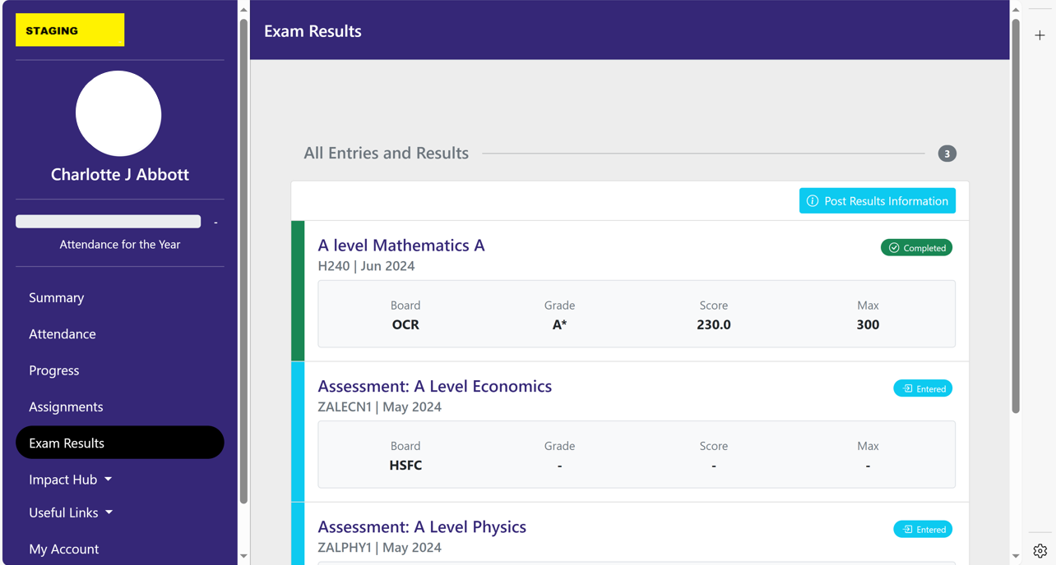
Exam Results

Slide 17
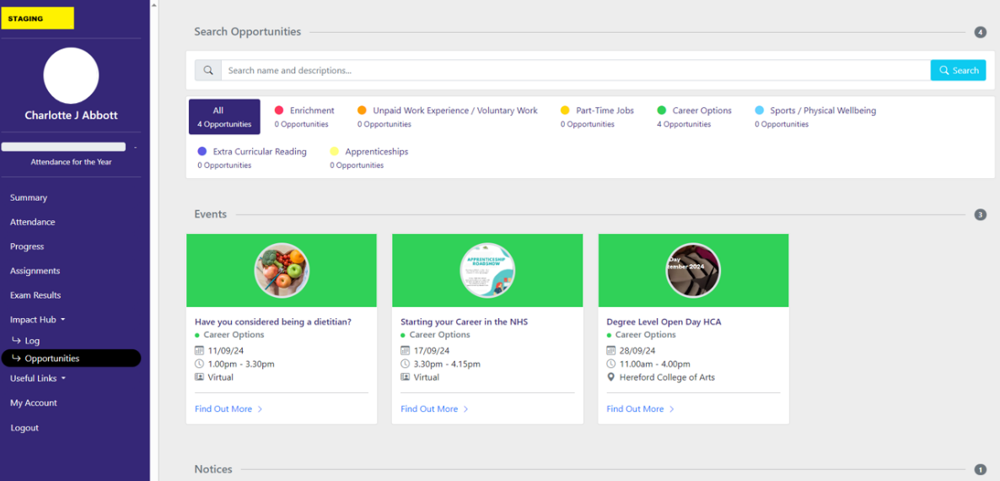
Impact Opportunities

Slide 18
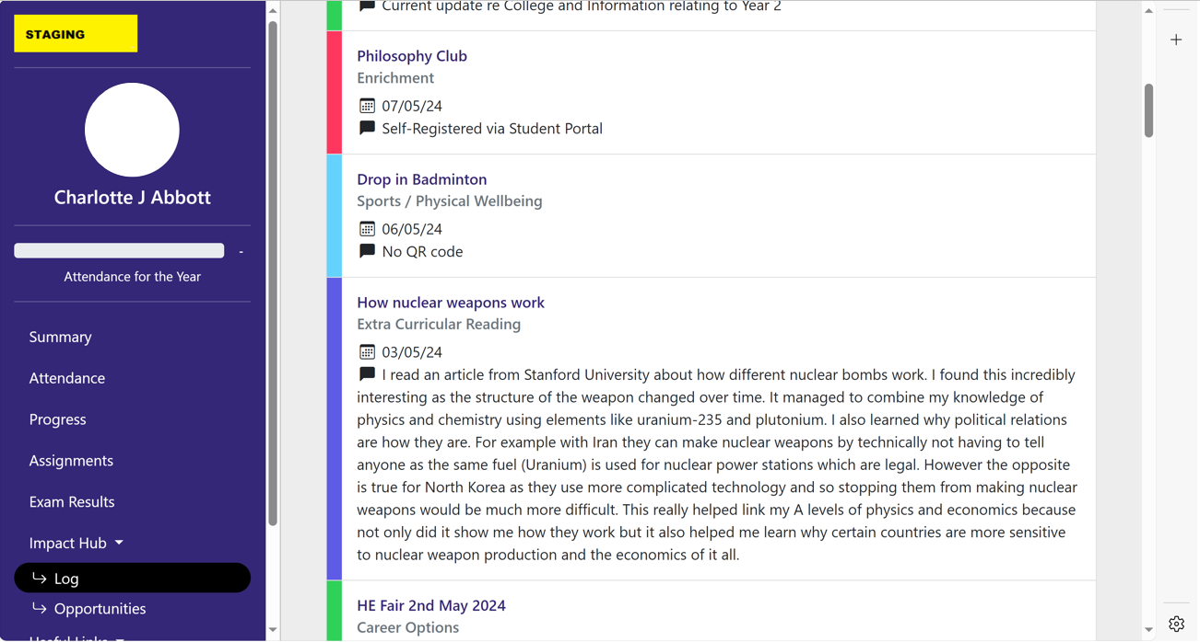
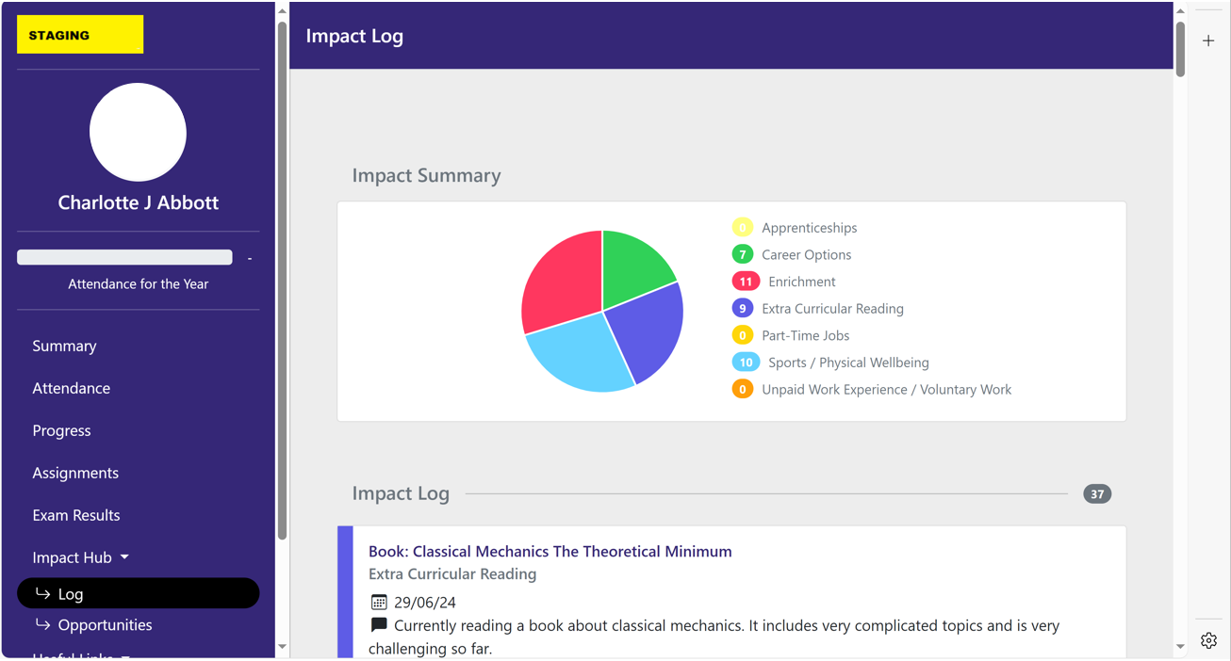
Impact Log

Slide 19
Pastoral Support
Attendance, homework completion, safeguarding, academic concern, course changes and counselling.
Catherine Brearey: Principal
Phil Tranter: Deputy Principal
Helen Osborn
Academic Progress Manager
Matt Bunston
Safeguarding and Pastoral Support
Jo Peters, Jules Price-Hutchinson, Gemma Cosgrove-Ball, Jade Finney
Lead Tutors
Personal Tutors: A Team of 10

Slide 20
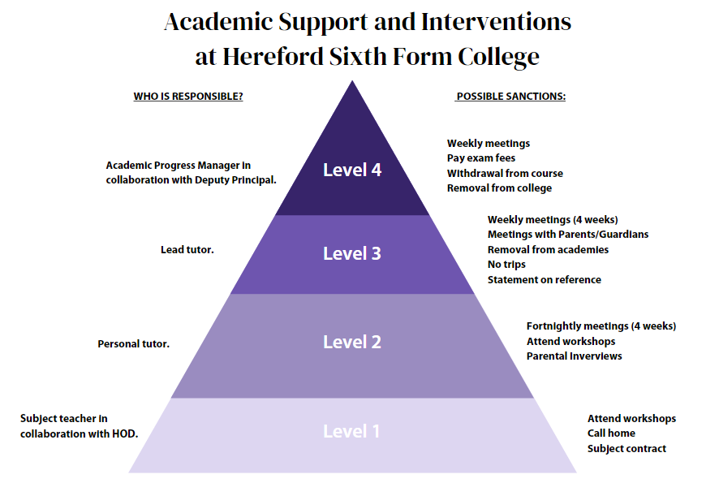
What happens when things go wrong?

Slide 21
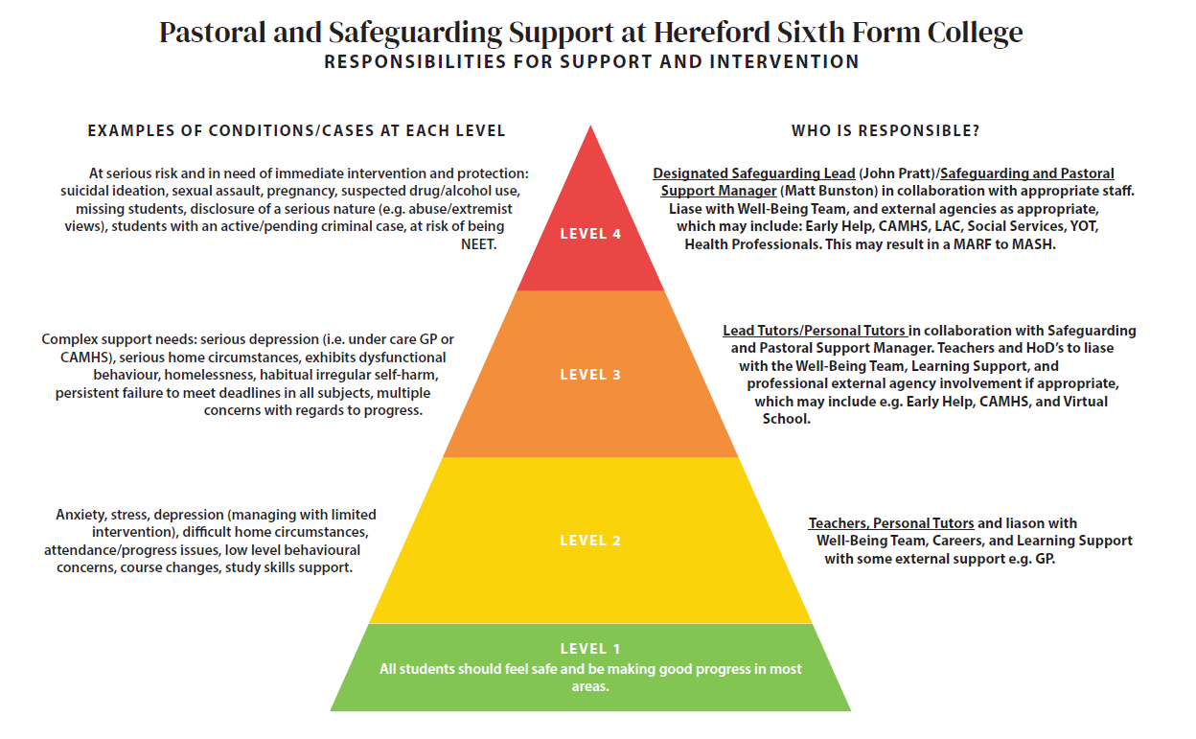

Slide 22

PARENTS
STUDENTS
STAFF

Slide 23

How does the partnership work with parents?
Progress and traffic lights
Timely reports
Parent Portal - students initiate sign up
Email or phone if issues arise
Work with the Personal Tutor
Parent’s evenings
Respond quickly

Slide 24
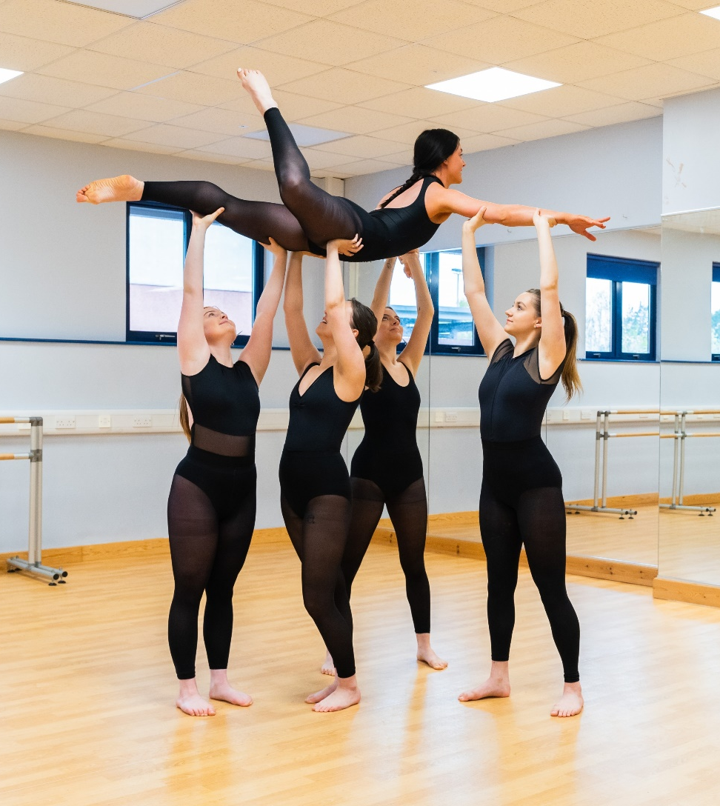
What can you do to help?
Encourage attendance
Be aware of college systems
Contact us if you feel there are any issues you wish to raise
Please don’t arrange holidays in term time
Respond to requests for information
Help when students are ill or injured
Support the Impact programme

Slide 25
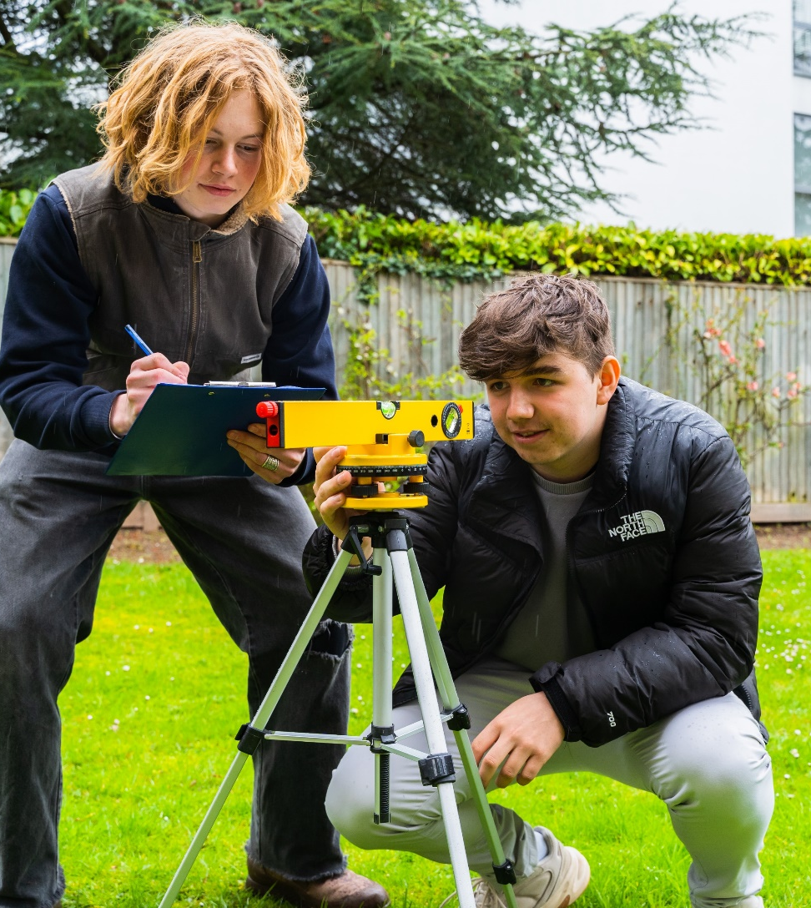
How can you help students in their time with us?
Encourage students to follow college procedures and regulations
Encourage them to engage with Learning Support if required (applications for access arrangements must be made by the end of March in 1st year)
Discuss progress
Encourage students to talk to us about problems

Slide 26

It can also be helpful to
Provide a suitable environment for study
Encourage a systematic approach to study
Limit part-time employment
Encourage regular routines which get enough sleep

Slide 27

Vocational/Applied General
Parent and Student Information 2024
Sophie Wheadon
Senior Curriculum Lead

Slide 28
2024-2026
L3 Applied General/Vocational
Offers
Forensic & Criminal Investigation (1.5)
Applied Psychology
Computing
Criminology
Dance
Digital Media Production
Enterprise
Engineering
Health & Social Care
IT
Musical Theatre
Performing Arts (Acting)
Sport
Sport & Exercise Science (2 & 1)
Travel and Tourism

Slide 29
Useful Terminology
BTEC/CTECH
Certificate = Year 1 of study (0.5 A Level)
Ext Certificate = Year 2, plus Year 1 results (1 A Level)
BTEC Foundation Diploma = 1.5 A Levels completed in 2 years
BTEC Diploma = (2 A Levels)
Criminology
Certificate = Year 1 of study (0.5 A Level)
Criminology Diploma = Year 2, plus Year 1 results (1 A Level)

Slide 30
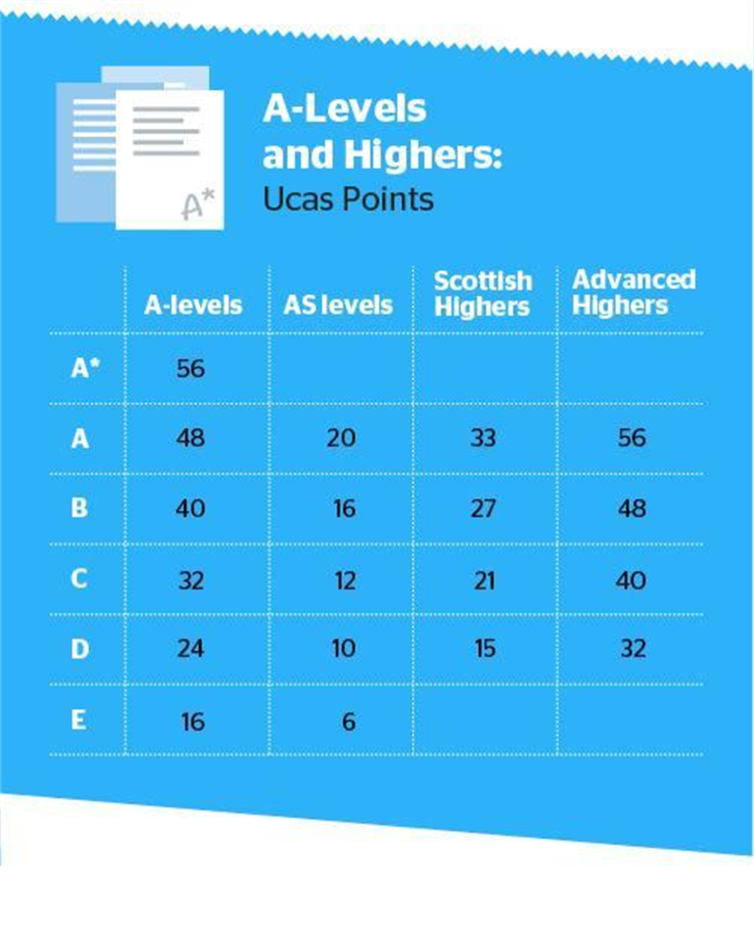
A Level Grades to UCAS Points

Slide 31
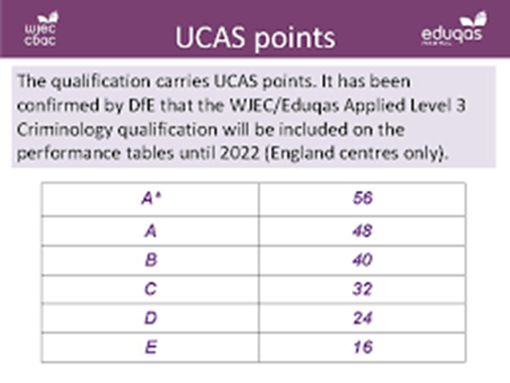
Criminology Grades to UCAS Points

Slide 32
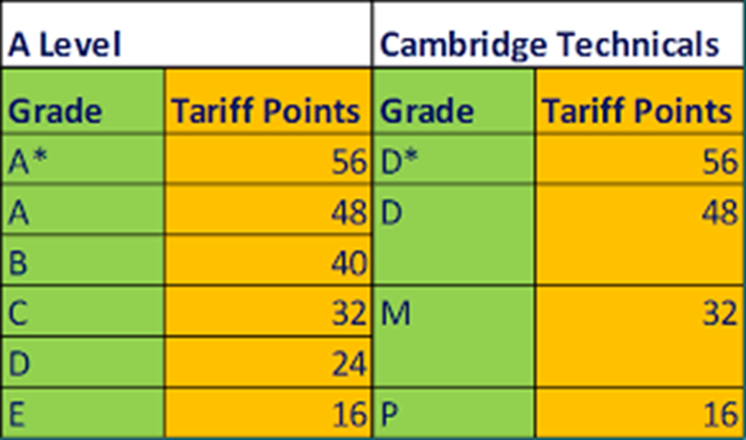
CTECH Grades to UCAS Points

Slide 33
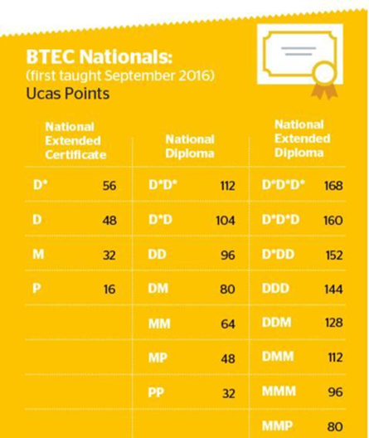
BTEC Grades to UCAS Points

Slide 34
Full Qualification
All courses have at least 4 units over two years.
Each unit has an individual unit grade (e.g. P,M or D)
Each unit is worth a specific number of points (e.g. 6, 10, 16)
All unit points are added up at the end to reach an overall full Qualification Grade.
It is this that we can compare to UCAS.

Slide 35

BTEC/CTECH External Assessment
Exam/Controlled Assessment
Set and marked by the Exam board
Dec/Jan and May/June Series
Resits allowed BUT paid for by the student.
More points available.
Dec Mocks are important, and we will report back prior to Christmas break.
If a student has an exam in Jan, it is essential they revise over the Christmas holidays.
Vocational Exams start on return to college of Jan 6th, 2025.

Slide 36
BTEC/CTECH
Internal Assessment
Critical Coursework/Assignments
Set and marked by the tutor
Internal Verification/Moderation
External Verification/Moderation
Resubmissions allowed – if criteria met!
Potential to FAIL – varies on course
Teams/Turnitin

Slide 37
Criminology (Applied General)
2 x External Assessments (exams).
2x Internal Assessments – Controlled Assessments marked internally and externally moderated.
Year 1 Controlled Assessment Dates:
10th Dec – 5 hours
11th Dec – 2/3 hours
18th Dec – extra time
Each unit is given a grade, the grade equates to points.
All points are added together to give a final qualification grade of A – E.

Slide 38
BTEC/CTECH Assessment, Submission and Resubmission Rules
Once the assessment has been set there are a few critical rules.
Learners must meet the initial submission deadline. (or an agreed extension)
Work must be authenticated.
All tasks must be attempted.
If a learner does not meet the above criteria work will not necessarily qualify for resubmission.

Slide 39

Assignments
Students must submit their own work via ‘Turnitin’.
Work can be submitted from anywhere as long as students can access the internet.
We encourage students to save all work on OneDrive so they can access this wherever they are.
Checks for originality and gives an originality score and detects AI misuse.
Allows platform for recording grades, giving feedback and providing verbal feedback.
Keeps learner work safe and secure.

Slide 40
Role of the Student/Parent Portal in the Assessment Process
As a student or parent, you should have live access to the portal which will keep you informed of when:
Assessments have been set and due for submission.
Assessments have been marked and graded.
Assessments have not met targeted criteria and have been awarded a resubmission opportunity.
New deadlines for resubmissions.
Resubmissions have not met targeted criteria and a retake has been awarded (BTEC only)
New deadlines for retake opportunities (BTEC only)
Resubmissions / Retakes will generate push notifications so you should always be aware of progress and current assessment requirements.

Slide 41
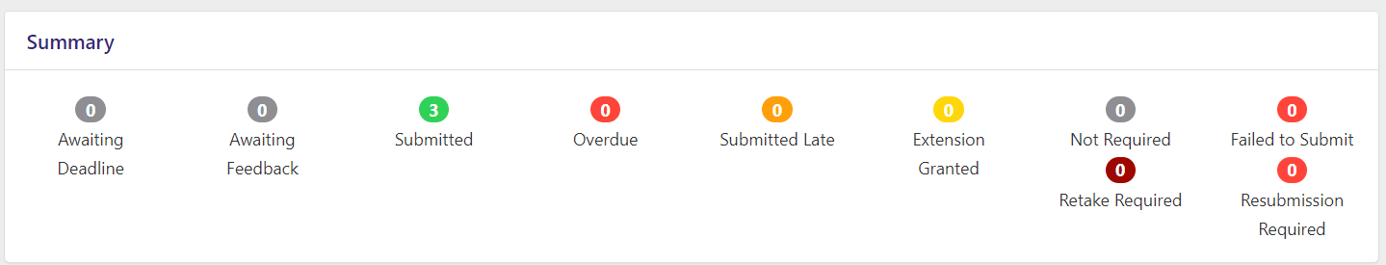
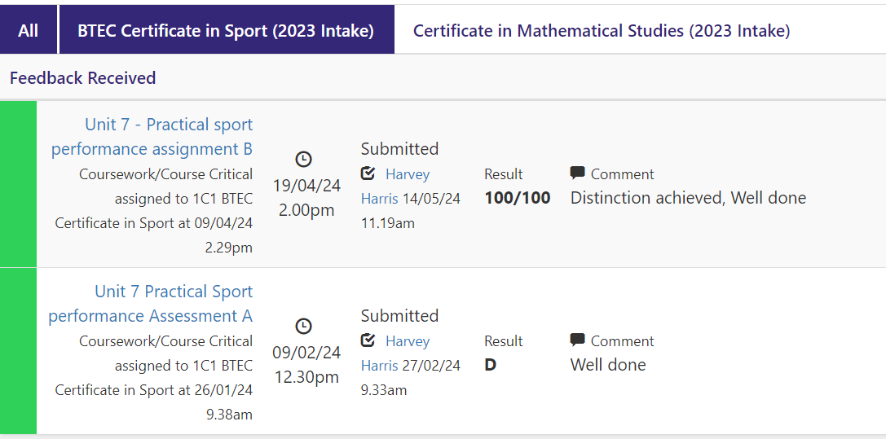
Assignment Portal

Slide 42
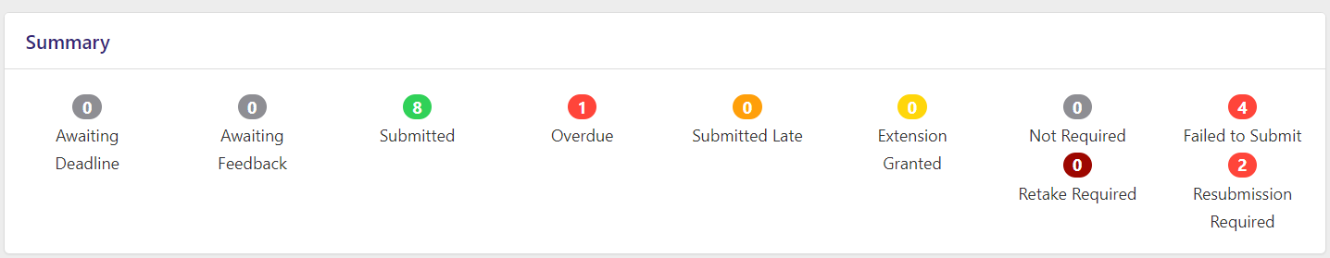
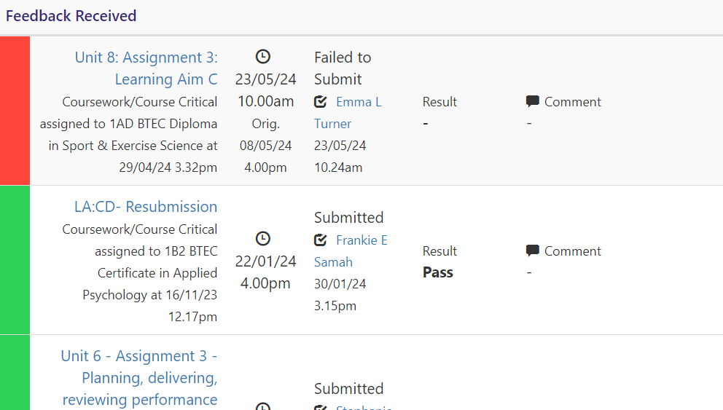
Assignment Portal

Slide 43

Assessment Points
Each course programme has an assessment plan.
This will be available to students (it is a working document).
The assessment plan will indicate when internal and external assessments are planned to take place.
Exams/External Assessment
Jan 2024 and May 2024
Mocks/College Internal Exams – December 2024/Possibly March 2025

Slide 44
Quality Assurance
Induction to the subject
Signed document (on portal)
Learner Declaration for internal assessments or planning work prepared for controlled assessment.
Malpractice/Plagiarism/Academic Honesty Incidence Report
Internal Verification
Appeals
Sampling Process (Standards Verification or External Moderation)

Slide 45
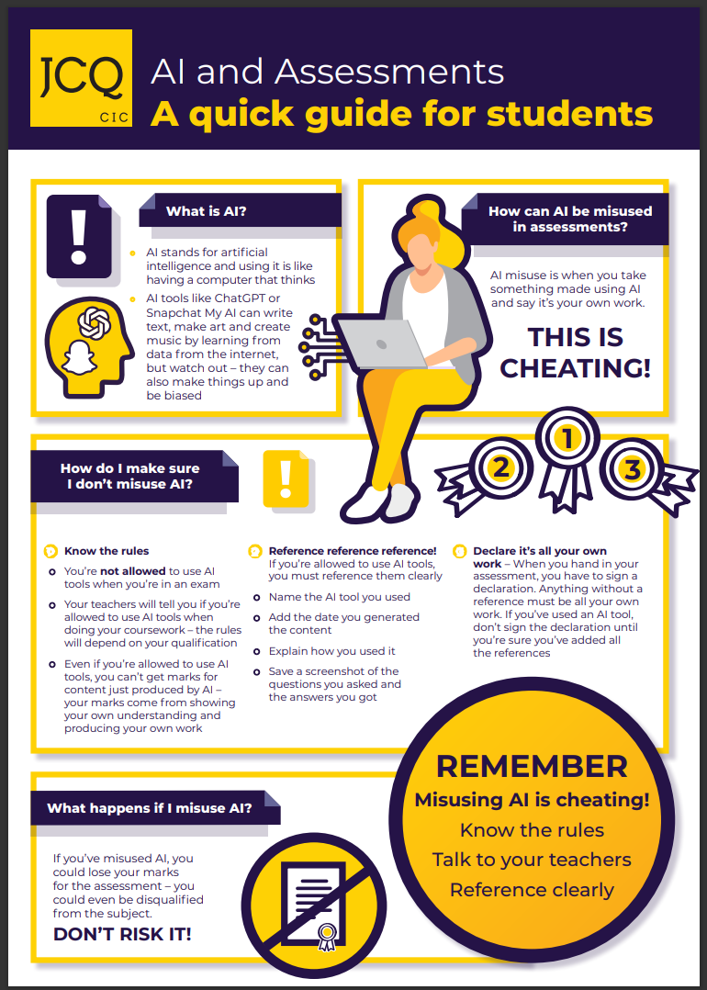
Artificial Intelligence in Assessment
Any work produced or generated using AI tools will be NOT be marked.

Slide 46

Sophie Wheadon
Senior Curriculum Lead (Vocational Qualifications)
Email: smw@hereford.ac.uk
Telephone: 01432 355166
*First point of contact the course tutor.

Slide 47
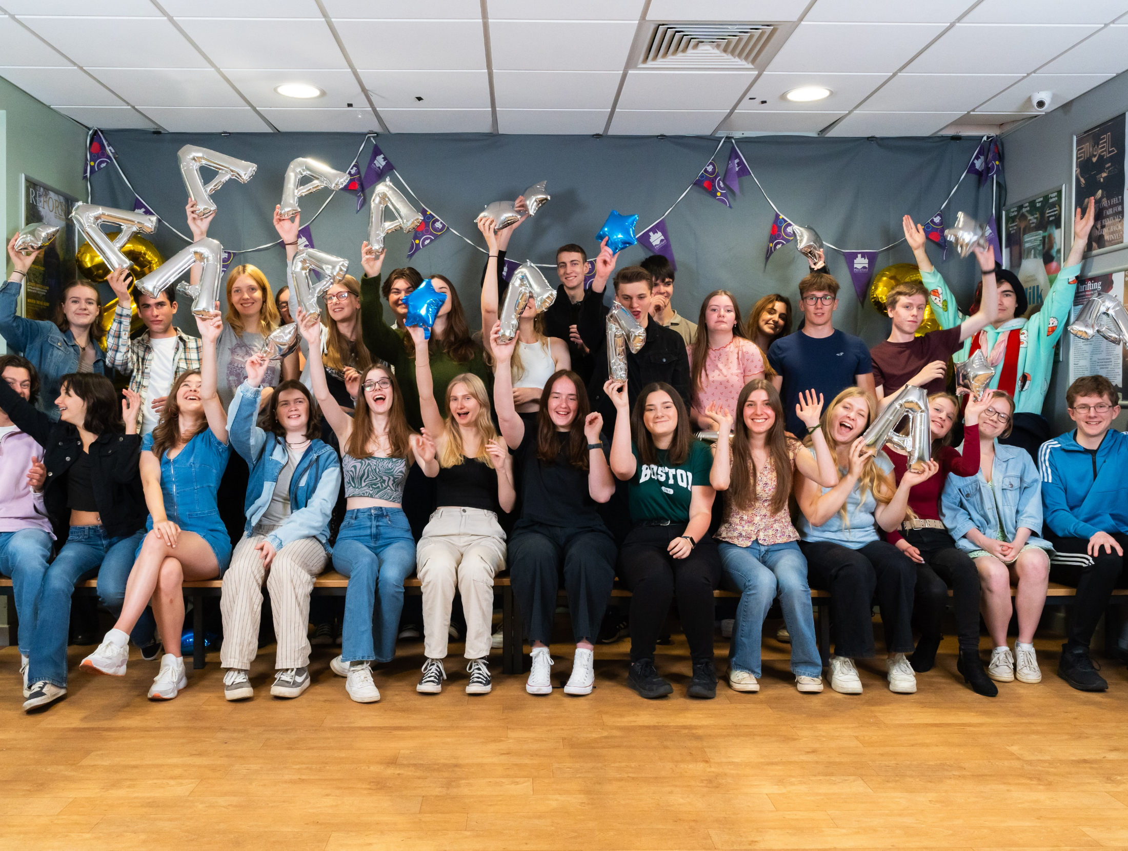
Thank you for making the time to join us and for choosing us.
We look forward to working with you.

Slide 48
Any Questions?
Tutor contacts

