Slide 1
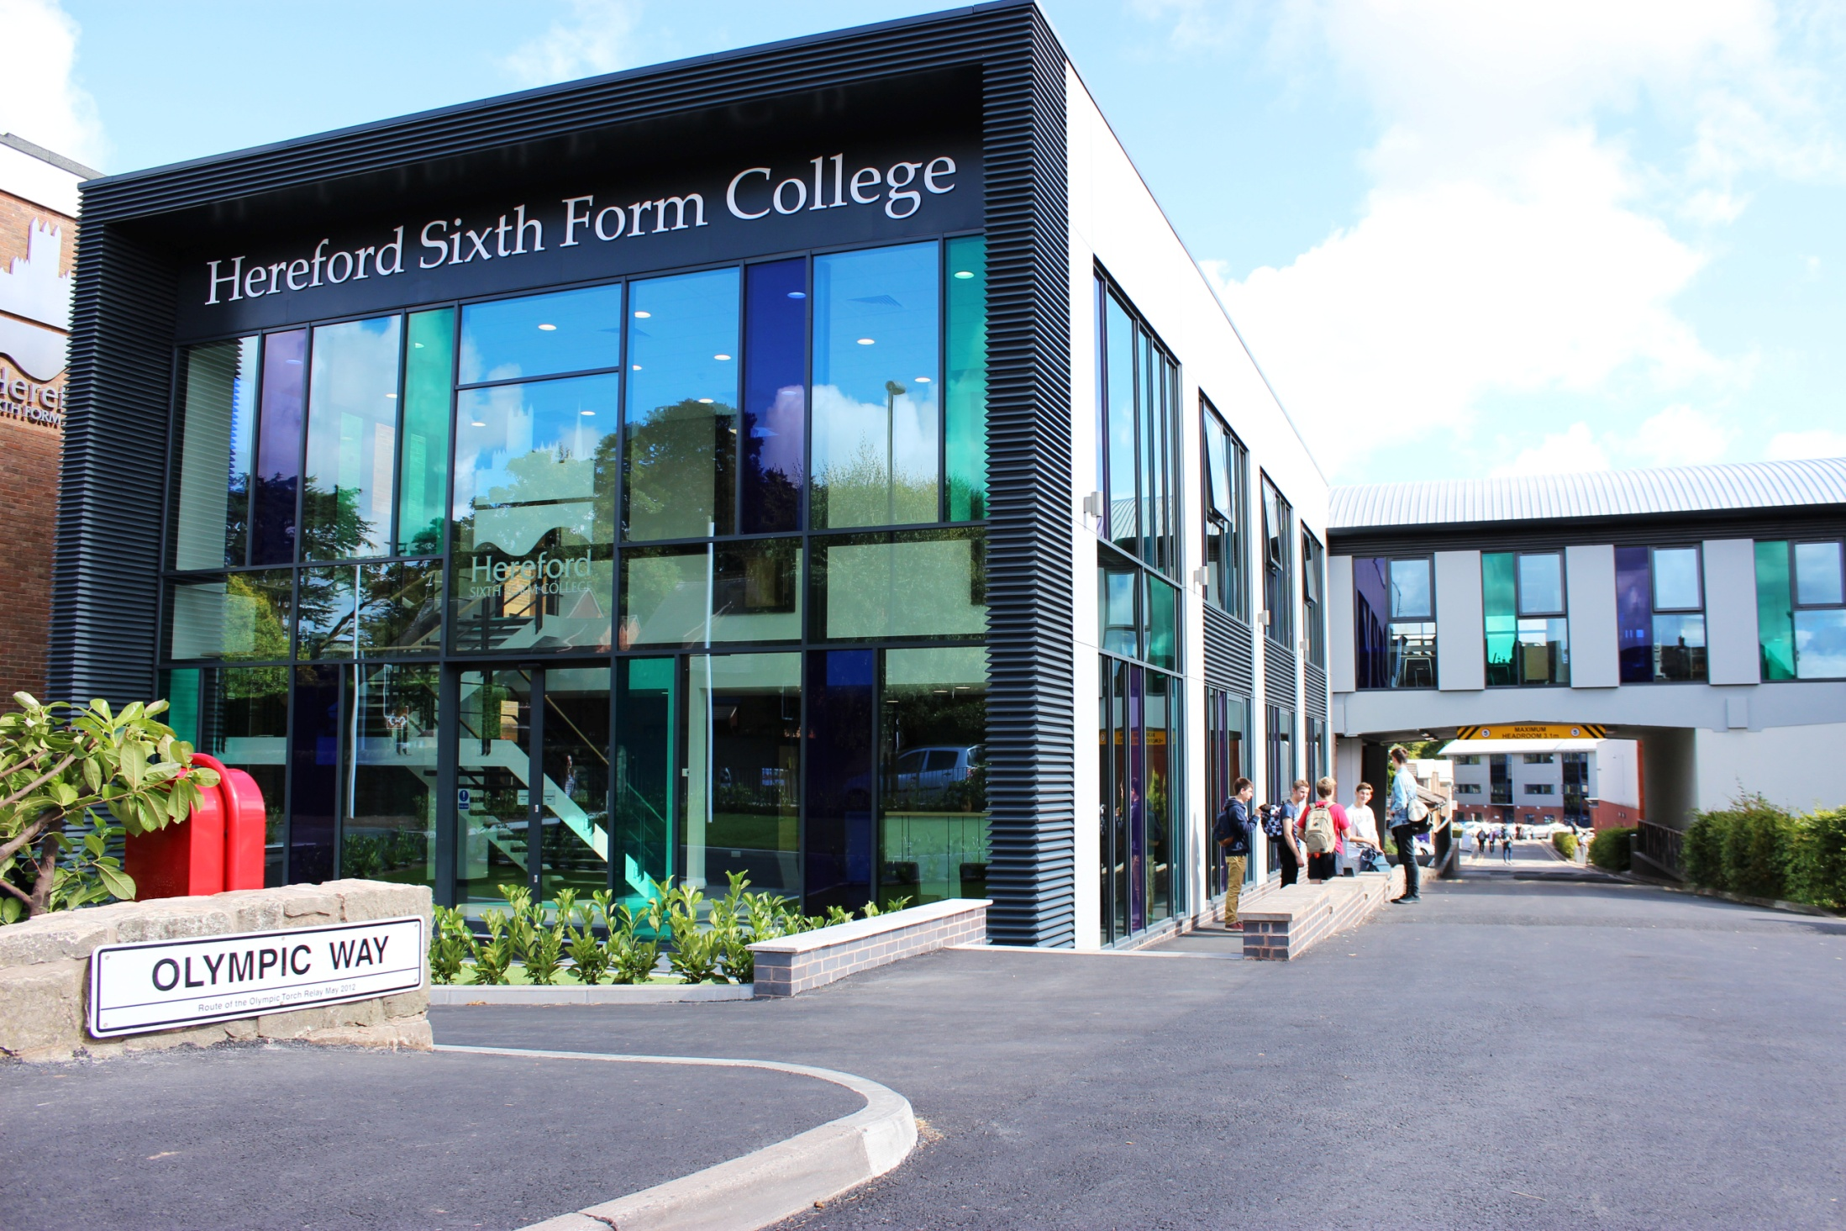

INFORMATION EVENING FOR PARENTS OF LEVEL 2 STUDENTS
September 2024
HEREFORD SIXTH FORM COLLEGE IS AS GOOD AS IT GETS IN THE STATE SECTOR FOR SIXTH FORM EDUCATION, IT GIVES INDEPENDENT SCHOOLS A TERRIFIC RUN FOR THEIR MONEY. - THE GOOD SCHOOLS GUIDE

Slide 2
Who is with you tonight?
Catherine Brearey Principal
Sophie Wheadon
Senior Vocational Curriculum Lead
Phil Tranter
Deputy Principal
Lead Tutors
Jules, Jade and Gemma

Slide 3

What do we want from our student’s time with us?
Course success
Give their maximum effort in all things
Get physically and mentally active - Impact!
Meet new friends
Help, respect and support each other
Enjoy their time

Slide 4
Careers
The importance of a grade 4/C in Maths and English:
Many recruiting universities will accept Grade 4/C in Maths and English for a range of degrees.
For example, the University of the West of England (Bristol - one of the most popular universities with our students) offer degree courses with GCSE grades 4 in the following subjects:
Nursing
Paramedic Science
Cyber Security and Digital Forensics
Interior design
Marketing
Other, more competitive universities will often ask for higher grades at GCSE.
Other careers that require English and Maths include:
Armed Forces
Sports Development and Coaching
Police

Slide 5
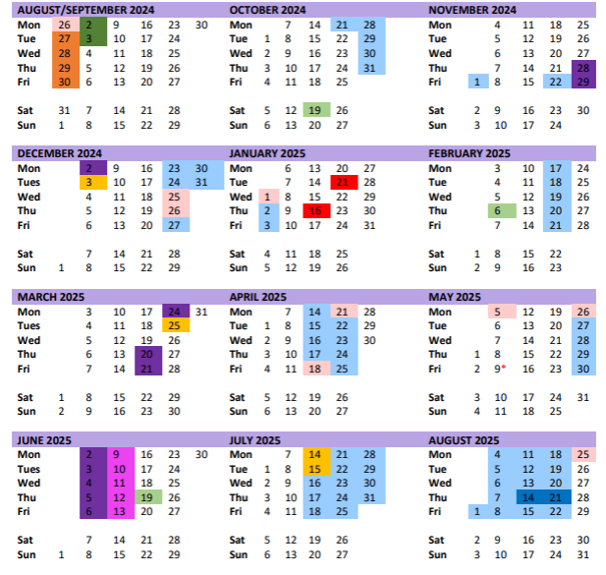
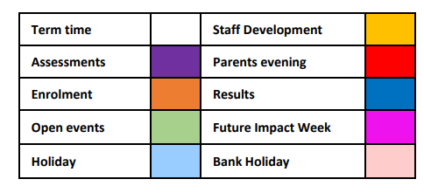
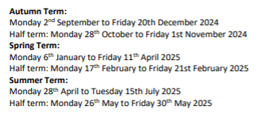
Overview of the year

Slide 6
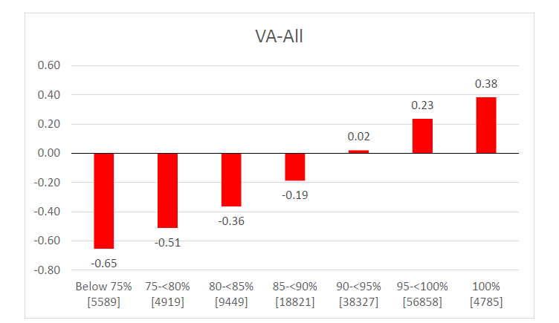
Attendance

Slide 7
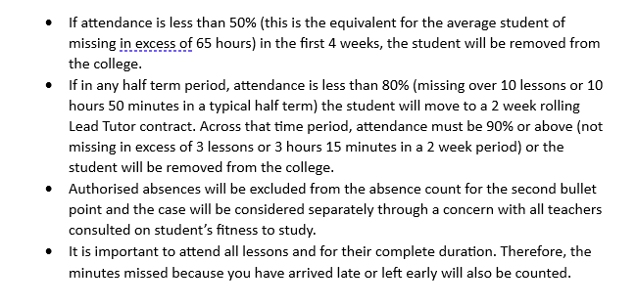
Attendance

Slide 8
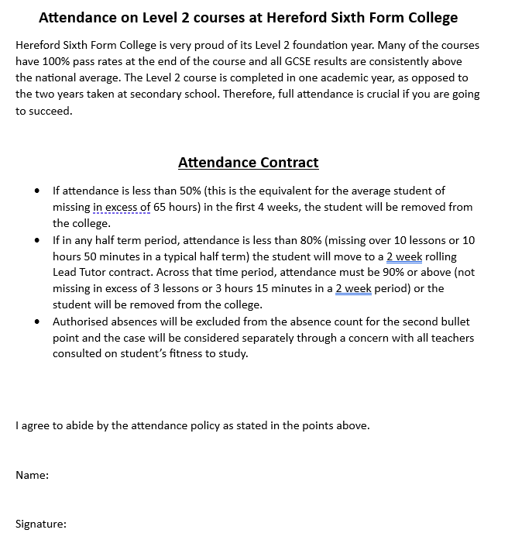
Attendance contract

Slide 9
Impact sessions
Bespoke careers advice
Study Skills
Essential life skills

Slide 10
Level 2 Programme of Study
Impact
Year 1
+
+
+
+
Years 2 & 3
Impact
CMS
EPQ
+
+
+

Slide 11
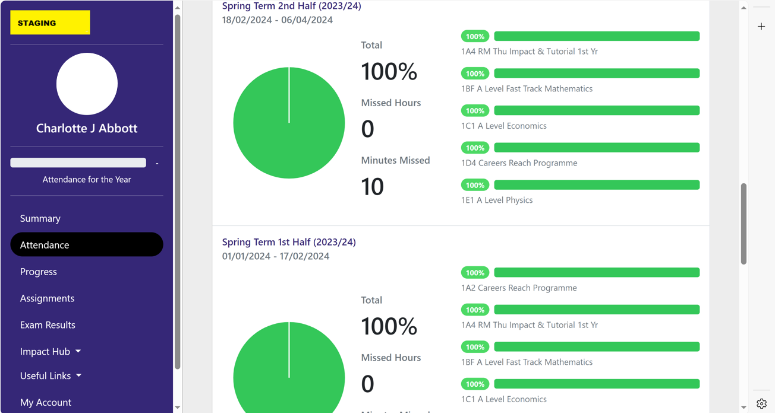
Parent Portal
Attendance

Slide 12
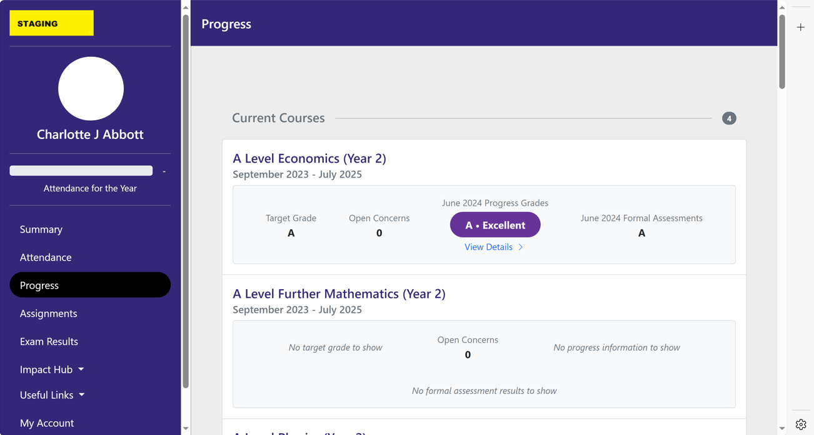
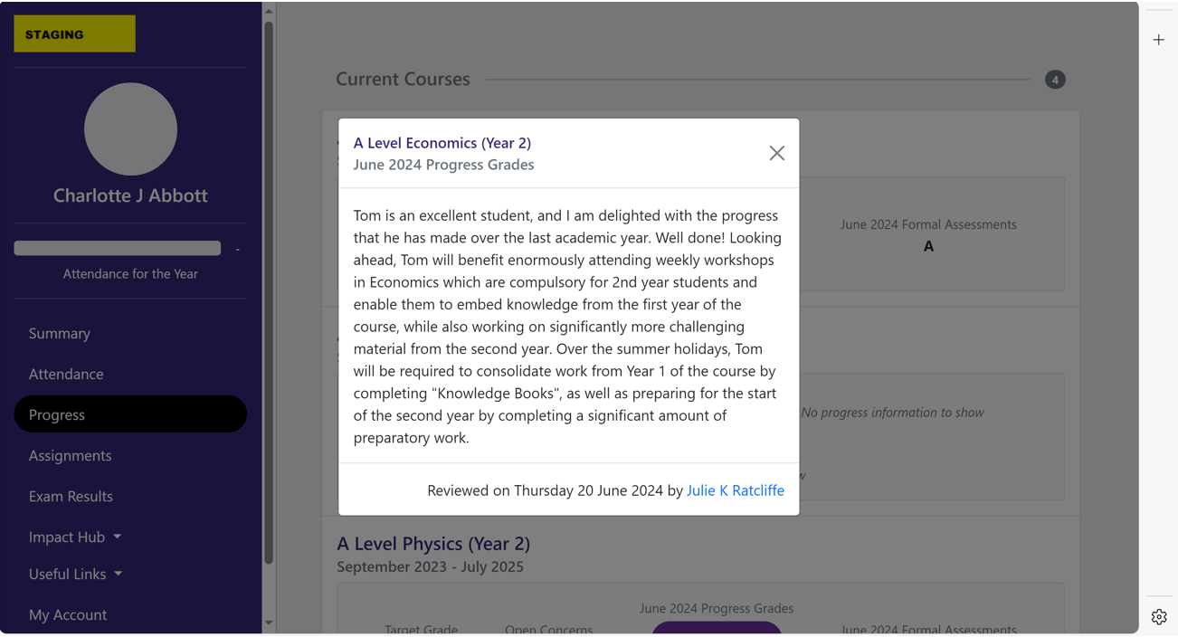
Progress
Progress Report

Slide 13
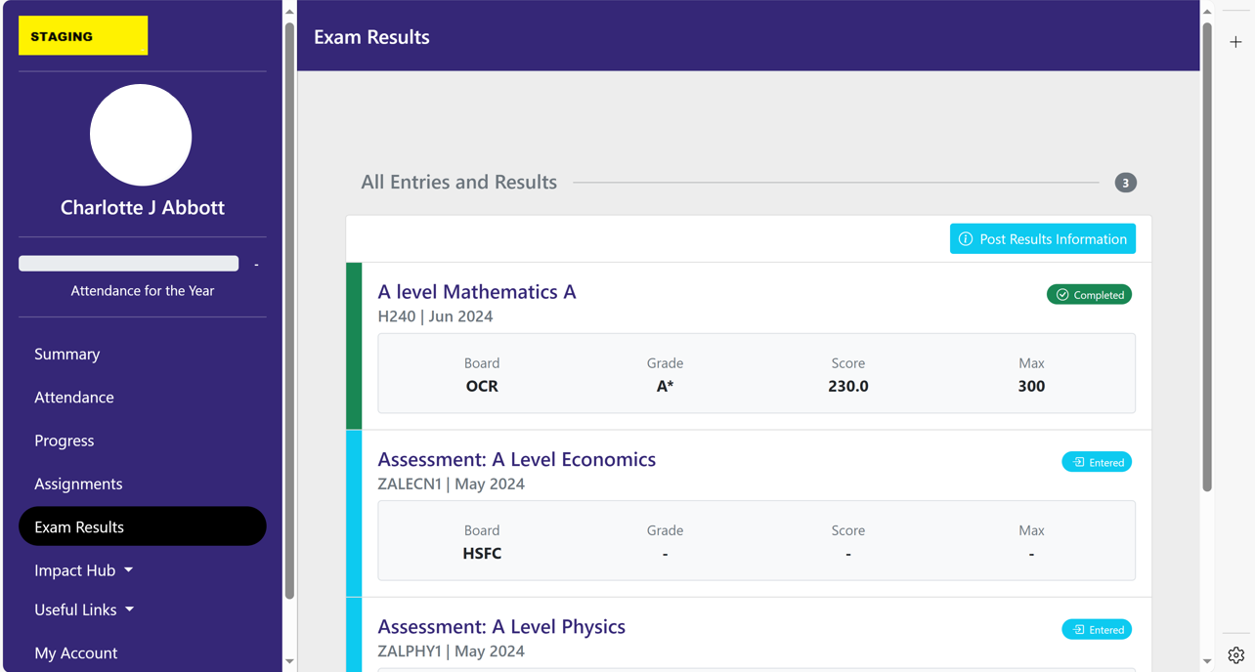
Exam Results

Slide 14
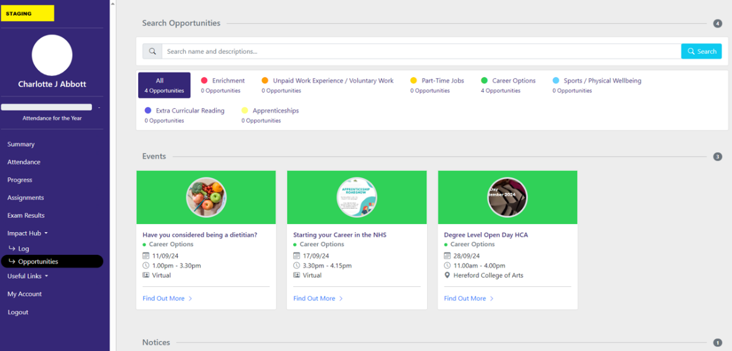
Impact Opportunities

Slide 15
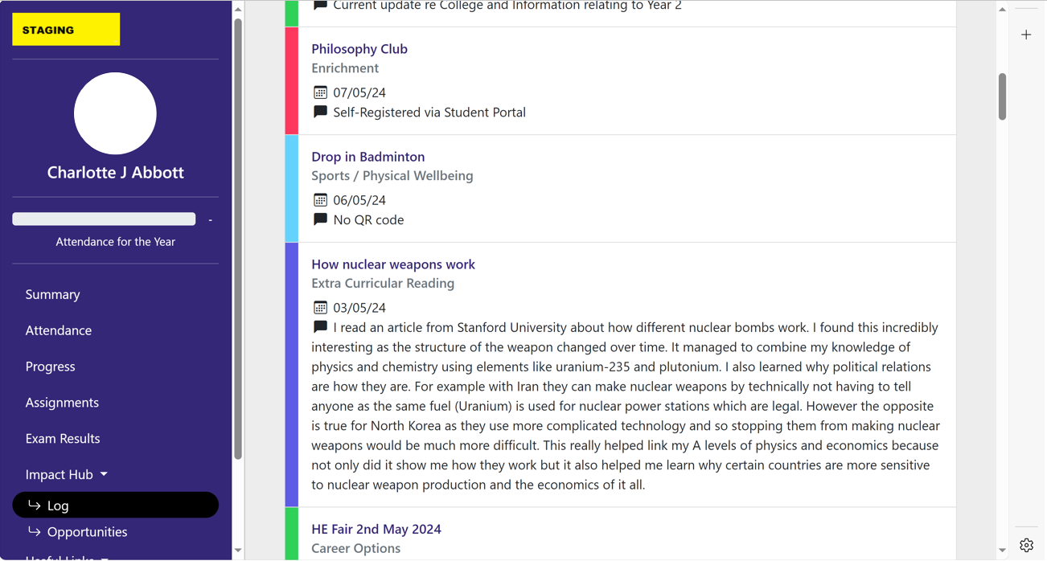
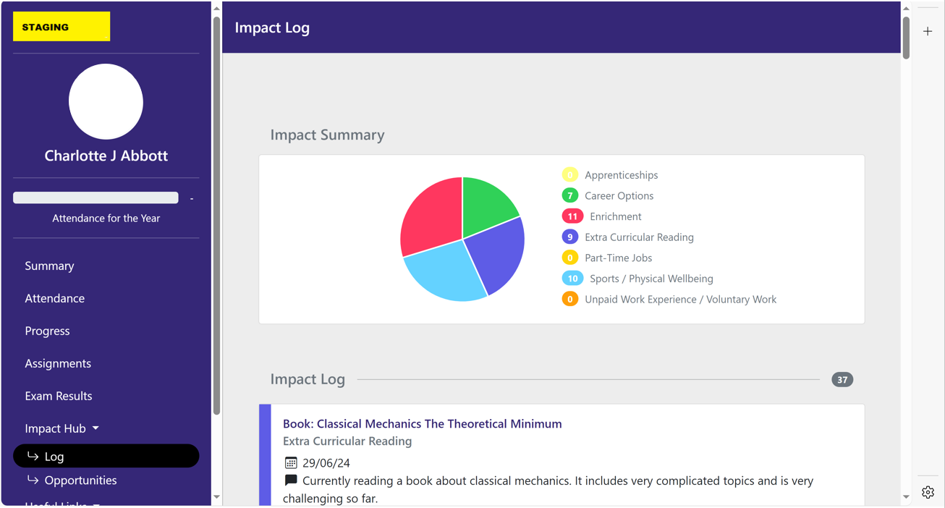
Impact Log

Slide 16
Pastoral Support
Attendance, homework completion, safeguarding, academic concern, course changes and counselling.
Catherine Brearey: Principal
Phil Tranter: Deputy Principal
Helen Osborn
Academic Progress Manager
Matt Bunston
Safeguarding and Pastoral Support
Jo Peters, Jules Price-Hutchinson, Gemma Cosgrove-Ball, Jade Finney
Lead Tutors

Slide 17
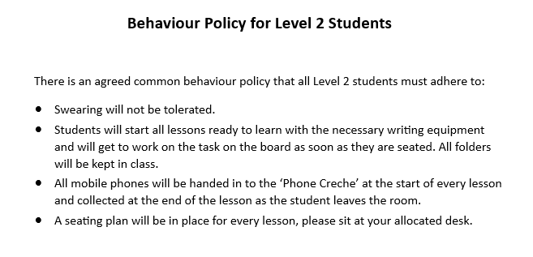
Behaviour Policy

Slide 18

How does the partnership work with parents?
Progress and traffic lights
Timely reports
Parent Portal - students initiate sign up
Email or phone if issues arise
Work with the Personal Tutor
Parent’s evenings
Respond quickly

Slide 19
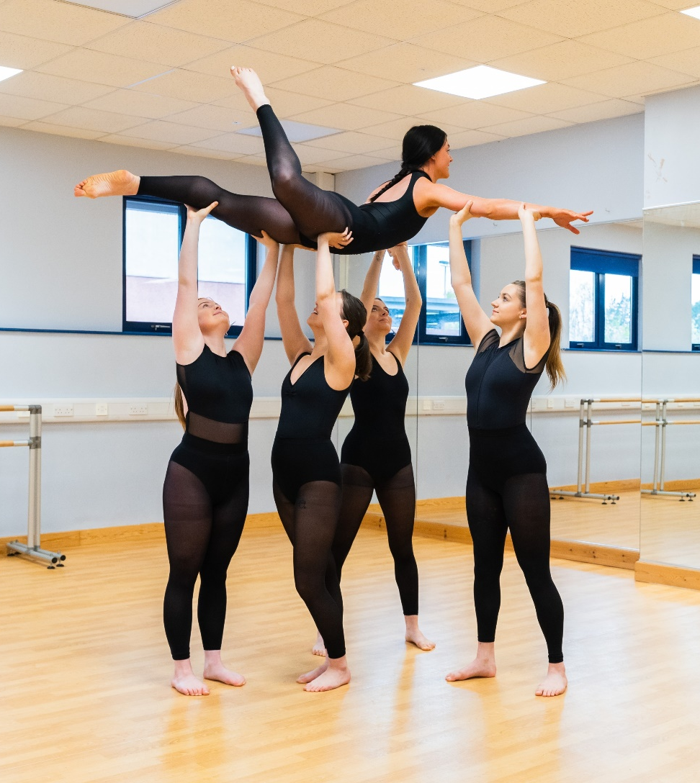
What can you do to help?
Encourage attendance
Be aware of college systems
Contact us if you feel there are any issues you wish to raise
Please don’t arrange holidays in term time
Respond to requests for information
Help when students are ill or injured
Support the Impact programme

Slide 20
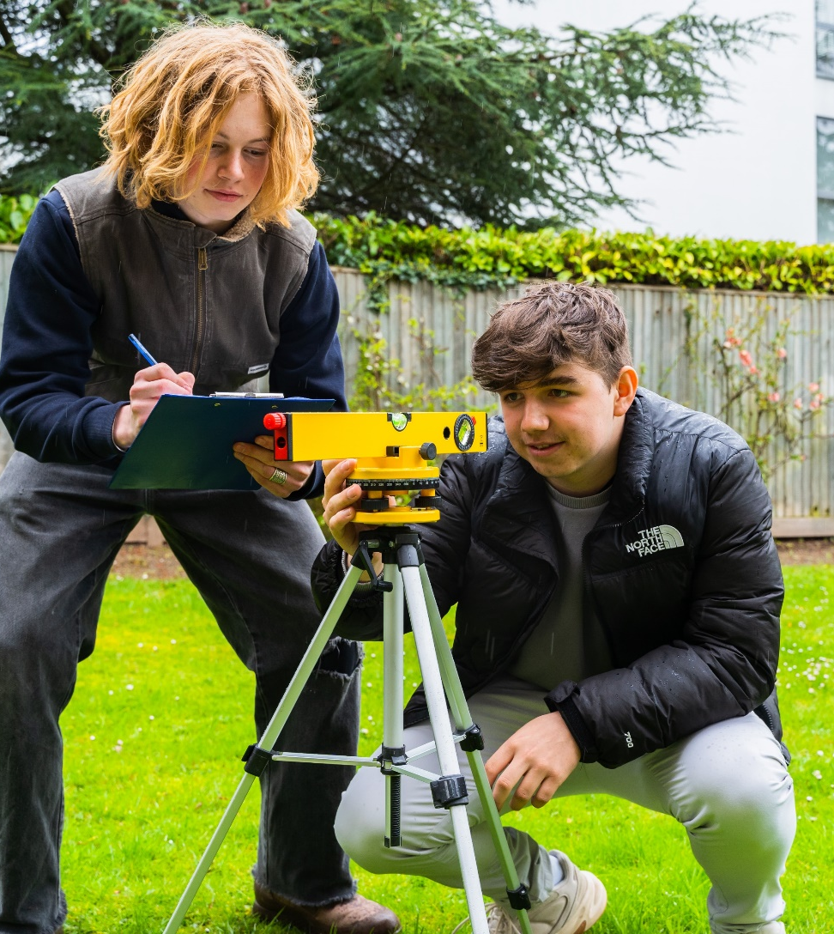
How can you help students in their time with us?
Encourage students to follow college procedures and regulations
Encourage them to engage with Learning Support if required (applications for access arrangements must be made by the end of March in 1st year)
Discuss progress
Encourage students to talk to us about problems

Slide 21

It can also be helpful to
Provide a suitable environment for study
Encourage a systematic approach to study
Limit part-time employment
Encourage regular routines which get enough sleep

Slide 22

Level 2 Vocational Subjects
Parent and Student Information 2024

Slide 23
2024-2025
Level 2
Programme Offers
Enterprise (BTEC First Award in Business 2018)
Travel and Tourism (BTEC First Award in Travel and Tourism 2018)
Health and Social Care – (BTEC Tech Award 2022)
OCR Cambridge National in Child Development

Slide 24
A full qualification is made up of separate units.
Each Unit has an individual unit grade
Each unit is worth a specific number of points.
All unit points are added up at the end to reach an overall full Qualification Grade.
There are both internal and external assessments on all courses.

Slide 25

External Assessment
Exam/Controlled Assessment
Set and marked by the Exam board
Dec/Jan and May/June Series
Resits allowed BUT paid for by the student.
Dec Mocks are important, and we will report back prior to Christmas break.
If a student has an exam in Jan, it is essential they revise over the Christmas holidays
Vocational Exams start on return to college of Jan 6th, 2025.

Slide 26
Critical Coursework/Assignments
Set and marked by the tutor
Internal Verification/Moderation
External Verification/Moderation
Resubmissions allowed – if criteria met!
Potential to FAIL – varies on course
Teams/Turnitin
Internal Assessment

Slide 27
BTEC Tech Award in Health and Social Care
3 components in total
Components 1 & 2 = non exam internal assessment – Pearson Set Assignments (PSA), moderated by the exam board. Released twice a year.
One opportunity to resubmit on each PSA.
Learners may have a single retake opportunity in a later assessment series using a new PSA
Component 3 is an external assessment.

Slide 28
Assessment, Submission and Resubmission Rules
Once the assessment has been set there are a few critical rules.
Learners must meet the initial submission deadline. (or an agreed extension)
Work must be authenticated.
All tasks must be attempted.
If a learner does not meet the above criteria work will not necessarily qualify for resubmission.

Slide 29

Assignments
Students must submit work via ‘Turnitin.
Work can be submitted from anywhere as long as students can access the internet.
Students will have the opportunity to familiarise themselves with ‘Turnitin’ before their first official submission.
Checks for originality and gives an originality score and AI misuse.
Allows platform for recording grades, giving feedback and providing verbal feedback.
Keeps learner work safe and secure.

Slide 30
Role of the Student/Parent Portal in the Assessment Process
The student / parent portal allows access to all Critical Coursework Assessment undertaken at HSFC.
As a student or parent, you should have live access to the portal which will keep you informed of when:
Assessments have been set and due for submission.
Assessments have been marked and graded.
Assessments have not met targeted criteria and have been awarded a resubmission opportunity.
New deadlines for resubmissions.
Resubmissions that have not met targeted criteria will result in a fail of the unit and therefore the course.
Resubmissions will generate push notifications so you should always be aware of progress and current assessment requirements.

Slide 31
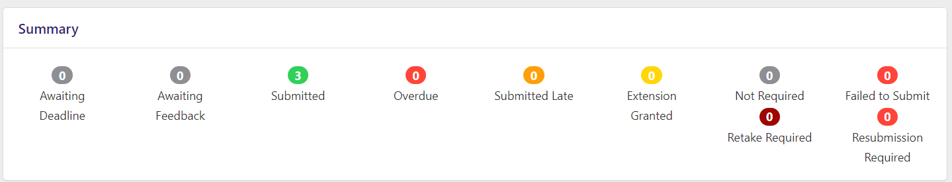
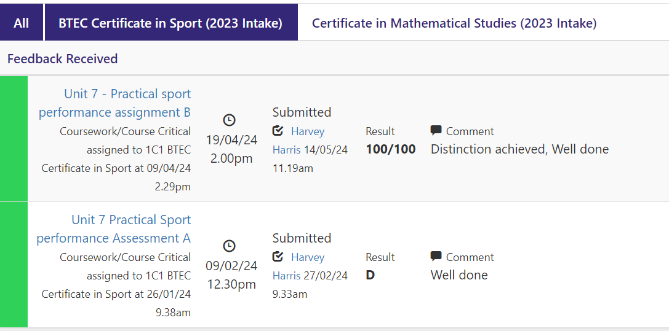
Assignment Portal

Slide 32
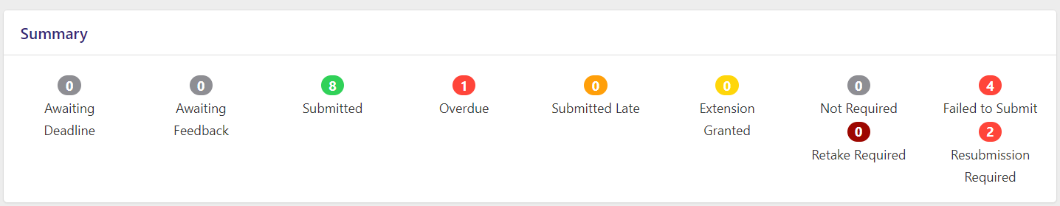
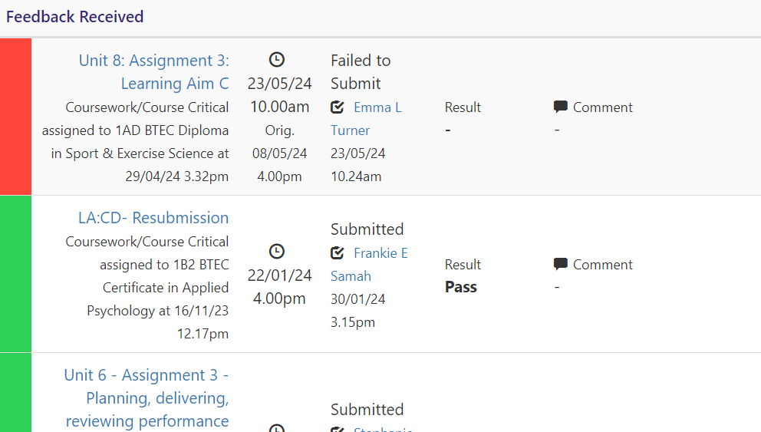
Assignment Portal

Slide 33

Assessment Points
Each course programme has an assessment plan.
This will be available to the students (it is a working document).
The assessment plan will indicate when internal and external assessments are planned to take place.
Exams/External Assessment
Jan 2024 and May 2024
Mocks/College Internal Exams – December 2024/Possibly March 2025

Slide 34
Quality Assurance
Induction to the subject
Signed document (on portal)
Learner Declaration on internal assessment or planning work prepared for controlled assessment.
Malpractice/Plagiarism/Academic Honesty Incidence Report
Internal Verification
Appeals
Sampling Process (Standards Verification or External Moderation)

Slide 35

Artificial Intelligence in Assessment
Any work produced or generated using AI tools will be NOT be marked.

Slide 36

Any Questions
Sophie Wheadon
Senior Curriculum Lead (Vocational Qualifications)
Email: smw@hereford.ac.uk
Telephone: 01432 355166
*First point of contact the course tutor.

Slide 37


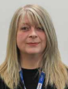
Lead Tutors
Gemma Cosgrove-Ball
Jade Finney
Jules Price-Hutchinson

