Slide 1
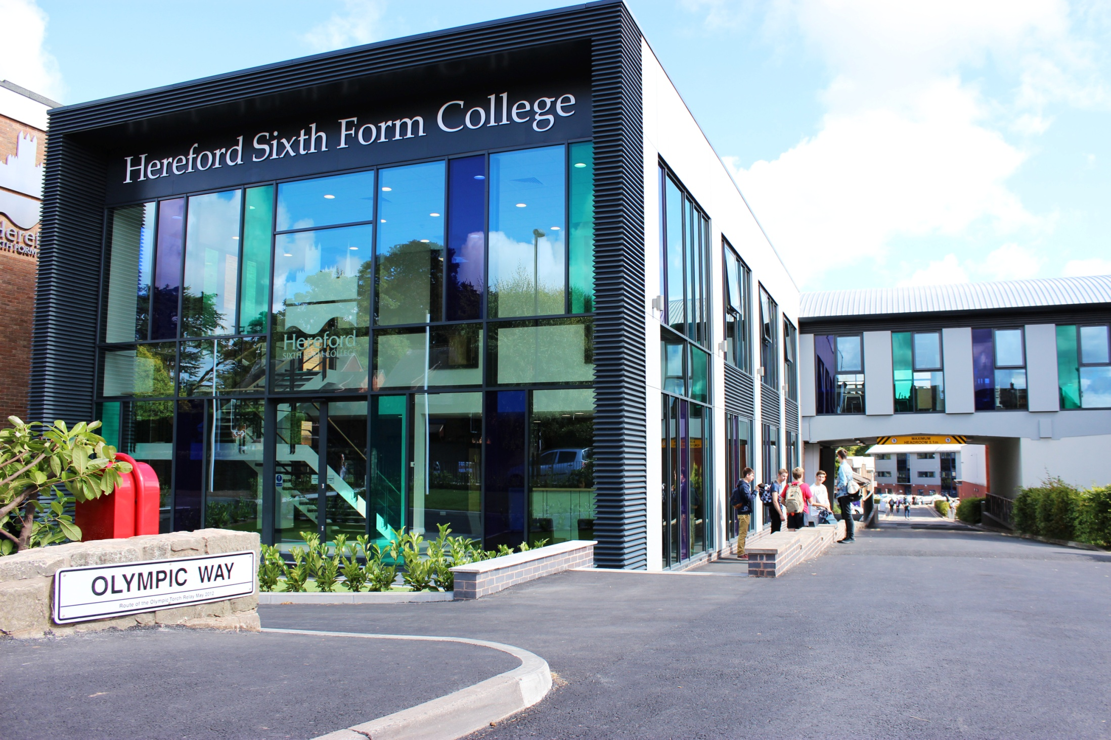

INFORMATION EVENING FOR PARENTS OF NEW STUDENTS
September 2023
HEREFORD SIXTH FORM COLLEGE IS AS GOOD AS IT GETS IN THE STATE SECTOR FOR SIXTH FORM EDUCATION, IT GIVES INDEPENDENT SCHOOLS A TERRIFIC RUN FOR THEIR MONEY. - THE GOOD SCHOOLS GUIDE

Slide 2
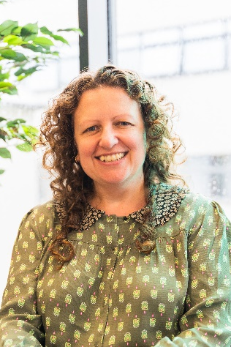
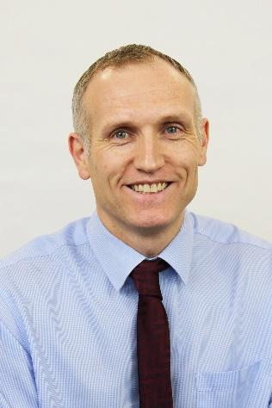
Who is with you tonight?
Catherine Brearey
Principal
Phil Tranter
Deputy Principal

Slide 3
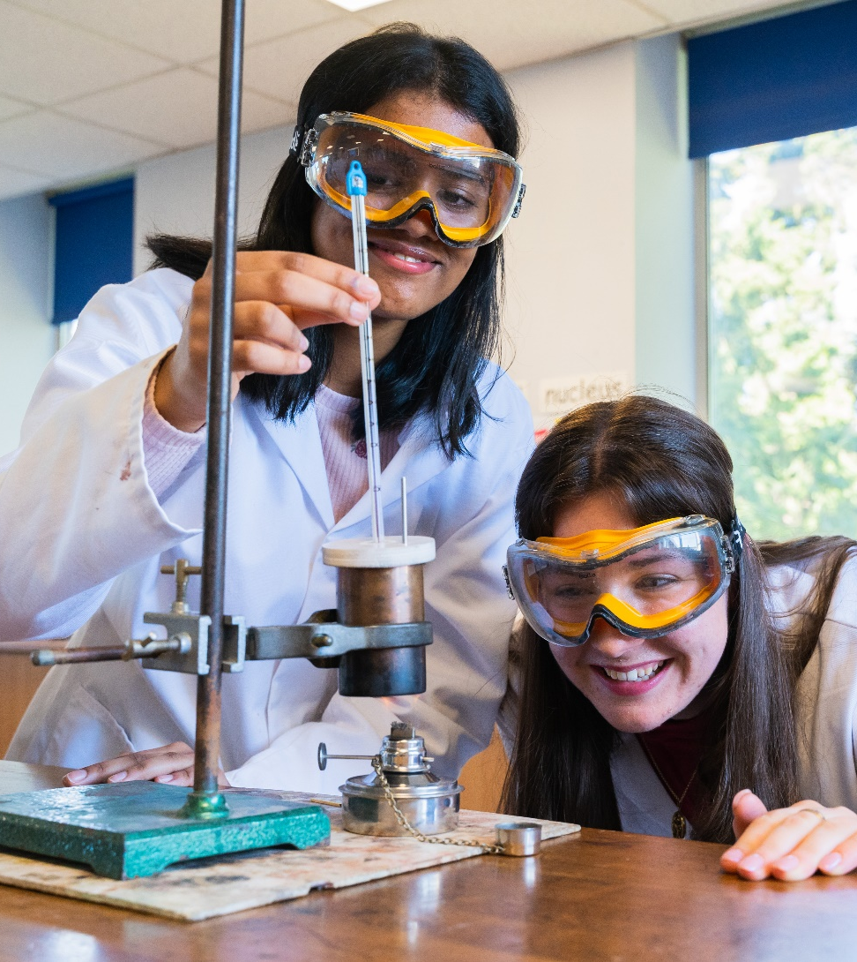
What we hope to do
Overview of the year
How we work with the students
How we keep in touch with you
Individual queries

Slide 4
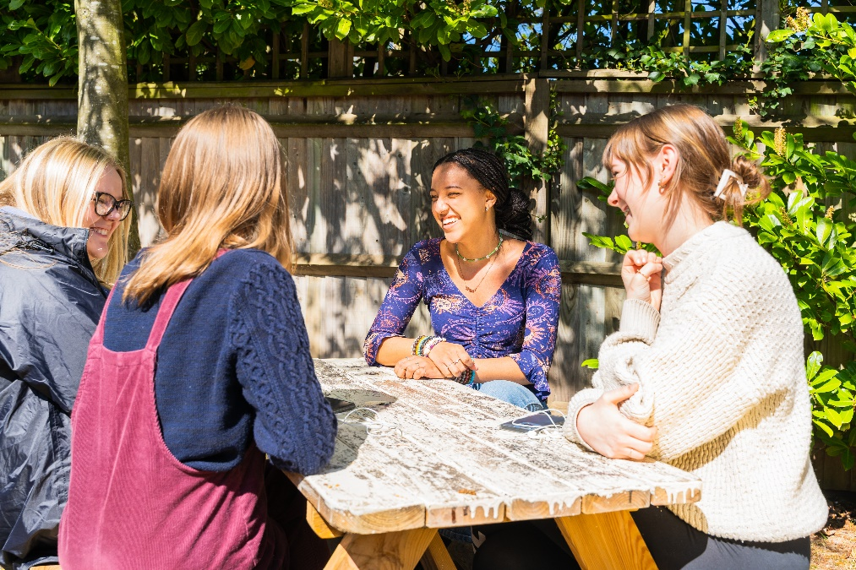
What do we want from our student’s time with us?
Course success
Give their maximum effort in all things
Get physically and mentally active - Impact!
Meet new friends
Help, respect and support each other
Enjoy their time

Slide 5
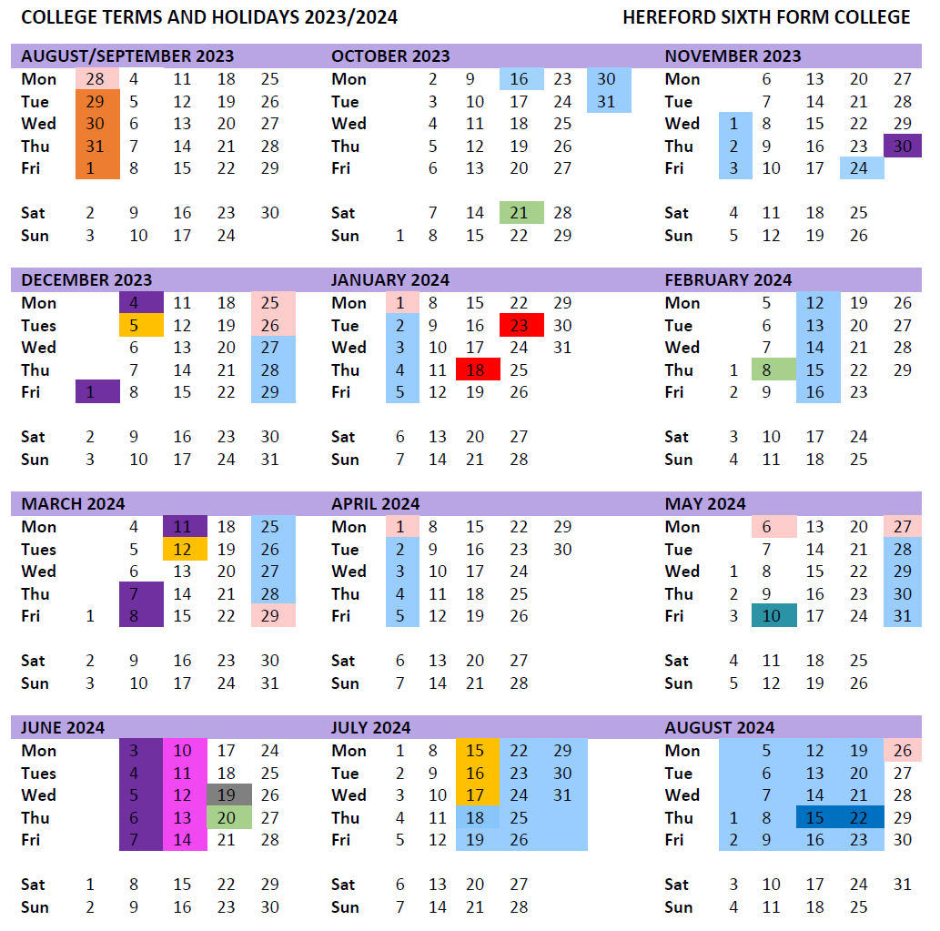
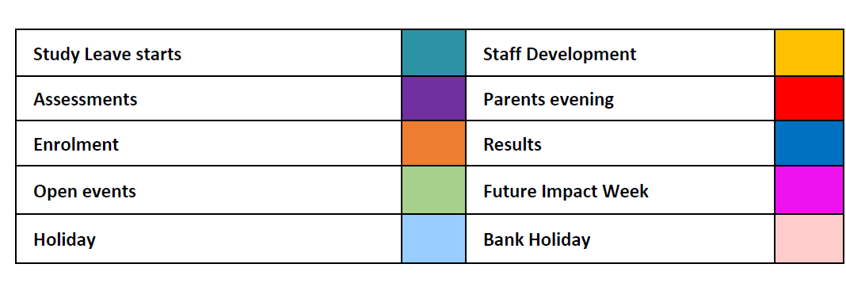
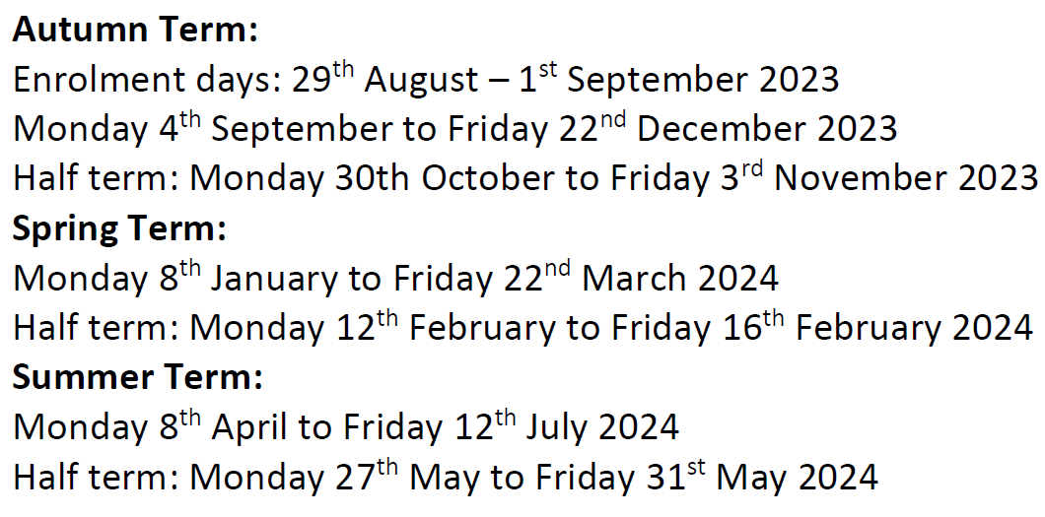
Overview of the year

Slide 6


Slide 7
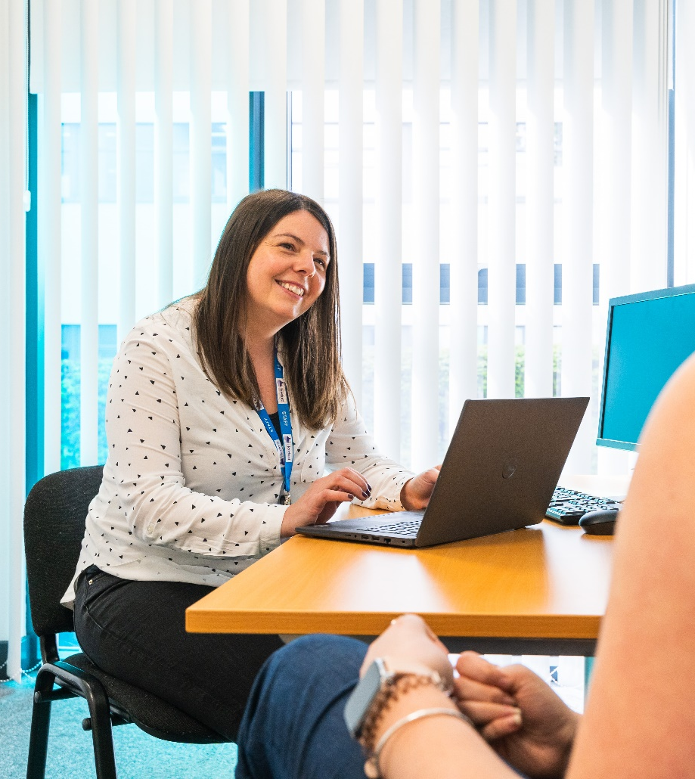
What we endeavour to deliver as our side of the Staff - Student partnership
Well planned courses, developing skills and relevant knowledge
Individual advice and guidance
Effective and supportive teaching
Close monitoring of progress and effective feedback
Intervention and extra input if it is required
All subjects have lunchtime workshops
Impact programme

Slide 8
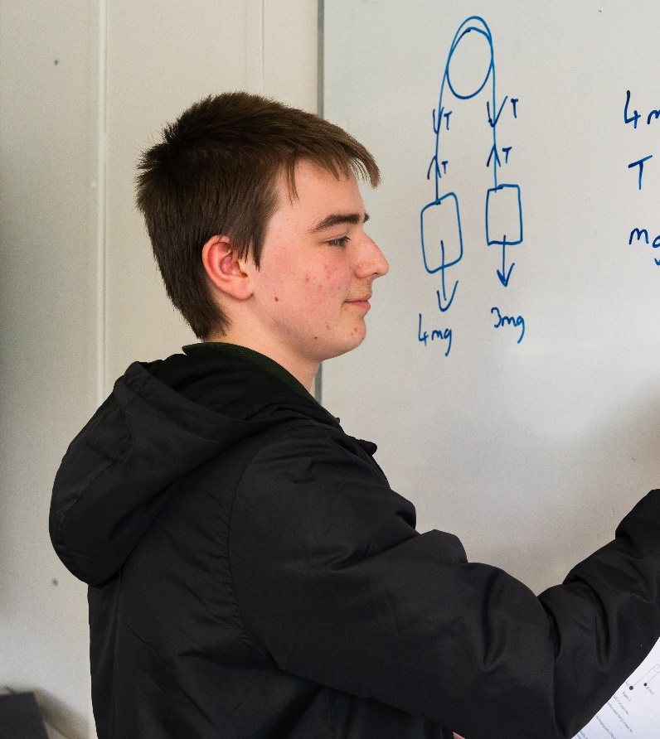
What do we expect from students?
Aim for 100% attendance
Low attenders (<90%) may have to pay for exam entries, may have the opportunity to attend trips withdrawn
Maintain high standards of commitment and responsibility
Complete all work to the highest possible standard 1st time
Organise work effectively in folders
Plan and manage study time effectively
Show respect and good manners to staff and one another
Seek help if problems arise - use the workshops
Get involved in the Impact programme
Help us to evaluate and improve

Slide 9


Slide 10
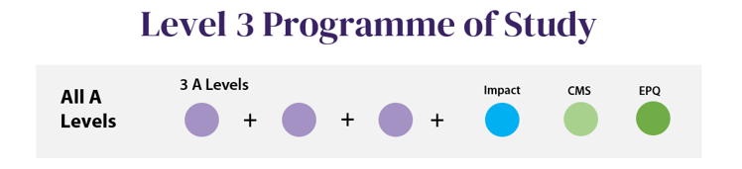
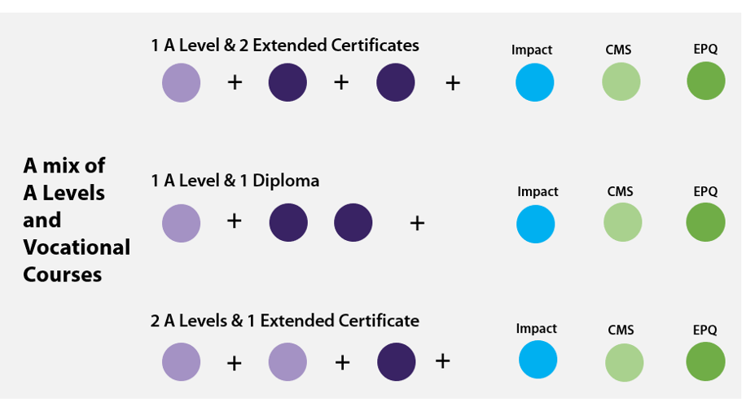
What will their programme of study look like?

Slide 11
Level 2 Programme of Study
Impact
Year 1
+
+
+
+
Years 2 & 3
Impact
CMS
EPQ
+
+
+

Slide 12
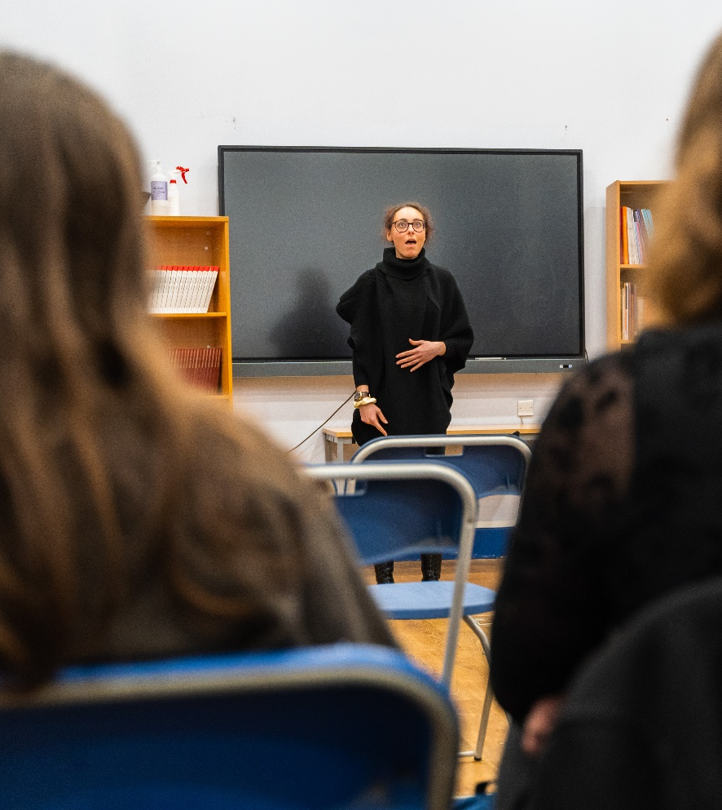
How are the workshops used?
4hrs 20 mins per subject
Up to 1hr 20 mins per subject directed time
Up to 5 hrs per subject homework
Workshops for help - available in all subjects but students will need to select and write these on their timetables to suit
Compulsory workshops - where remedial work needs to be completed

Slide 13
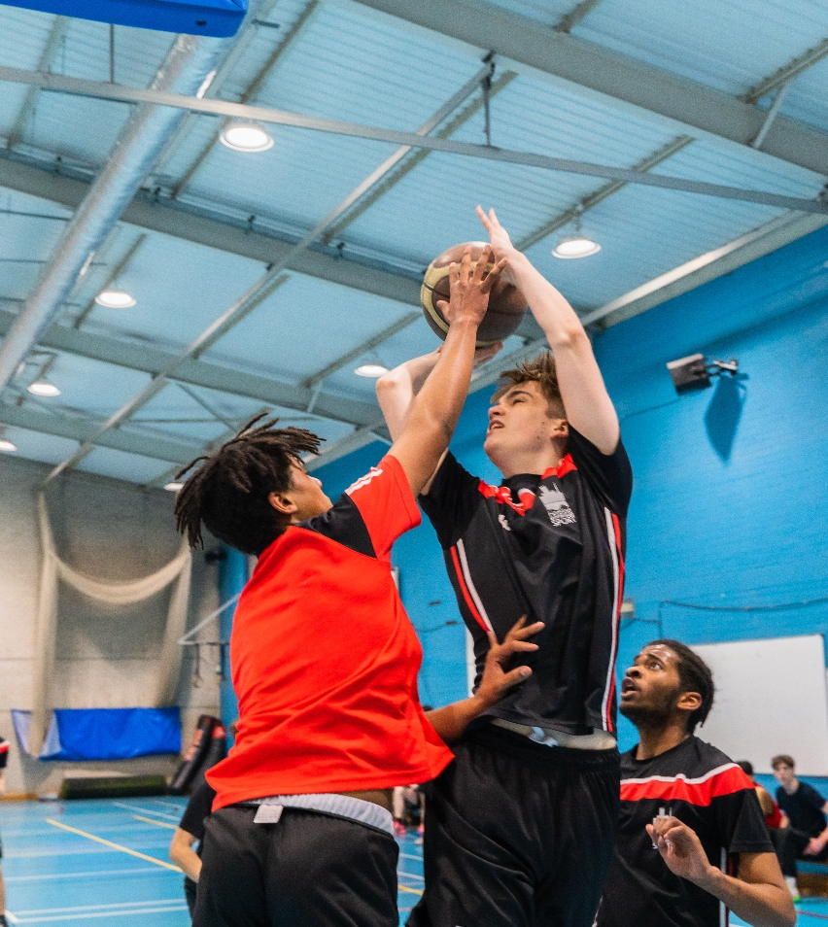
We will set them realistic targets
Attendance and organisation
Minimum Target Grade (MTG)
- Based on average GCSE score
- Varies from subject to subject

Slide 14
Minimum Target Grade
(A)
(C)
(E)
Average A Level Grade
(4) (5) (6) (7) (8) (9)
Average GCSE Grade

Slide 15
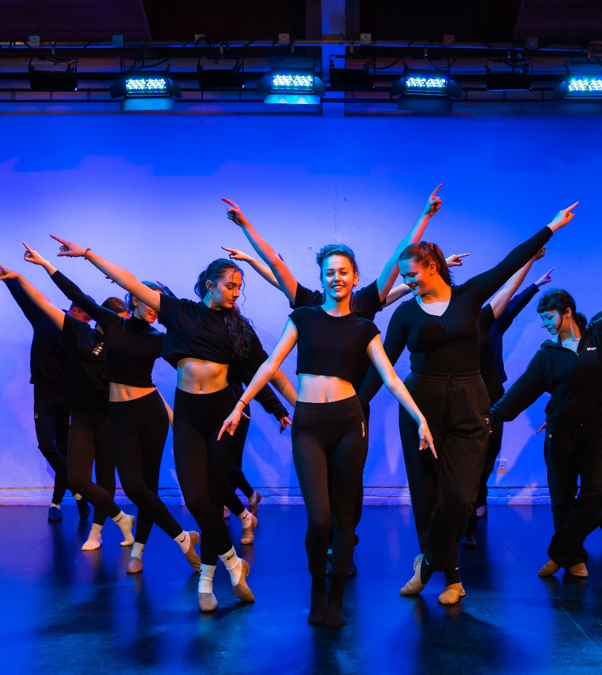
How can students check their development?
Progress grades
Effort and commitment to learning ‘traffic lights’
Monitoring by:
- Subject Tutors
- Personal Tutor
- Lead Tutor and Academic Progress
Manager

Slide 16
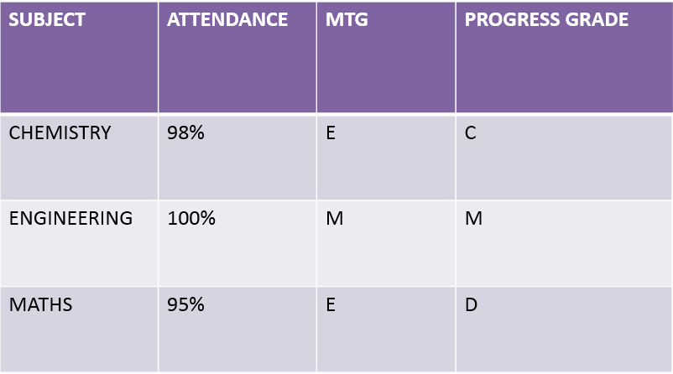
Progression monitoring

Slide 17
Pastoral Support
Attendance, homework completion, safeguarding, academic concern, course changes and counselling.
Catherine Brearey: Principal
Phil Tranter: Deputy Principal
Helen Osborn
Academic Progress Manager
Matt Bunston
Safeguarding and Pastoral Support
Emma Horton
Mentor for Students with ADHD
Mel Powell
Mentor for Students on the Autistic Spectrum
Trish Donnelly, Jane McDonnell, Gemma Cosgrove-Ball, Jade Finney
Lead Personal Tutors
Personal Tutors: A Team of 10

Slide 18
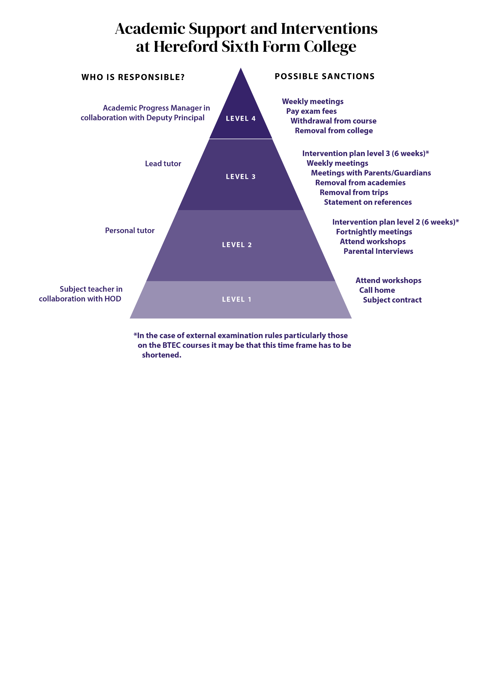
What happens when things go wrong?

Slide 19
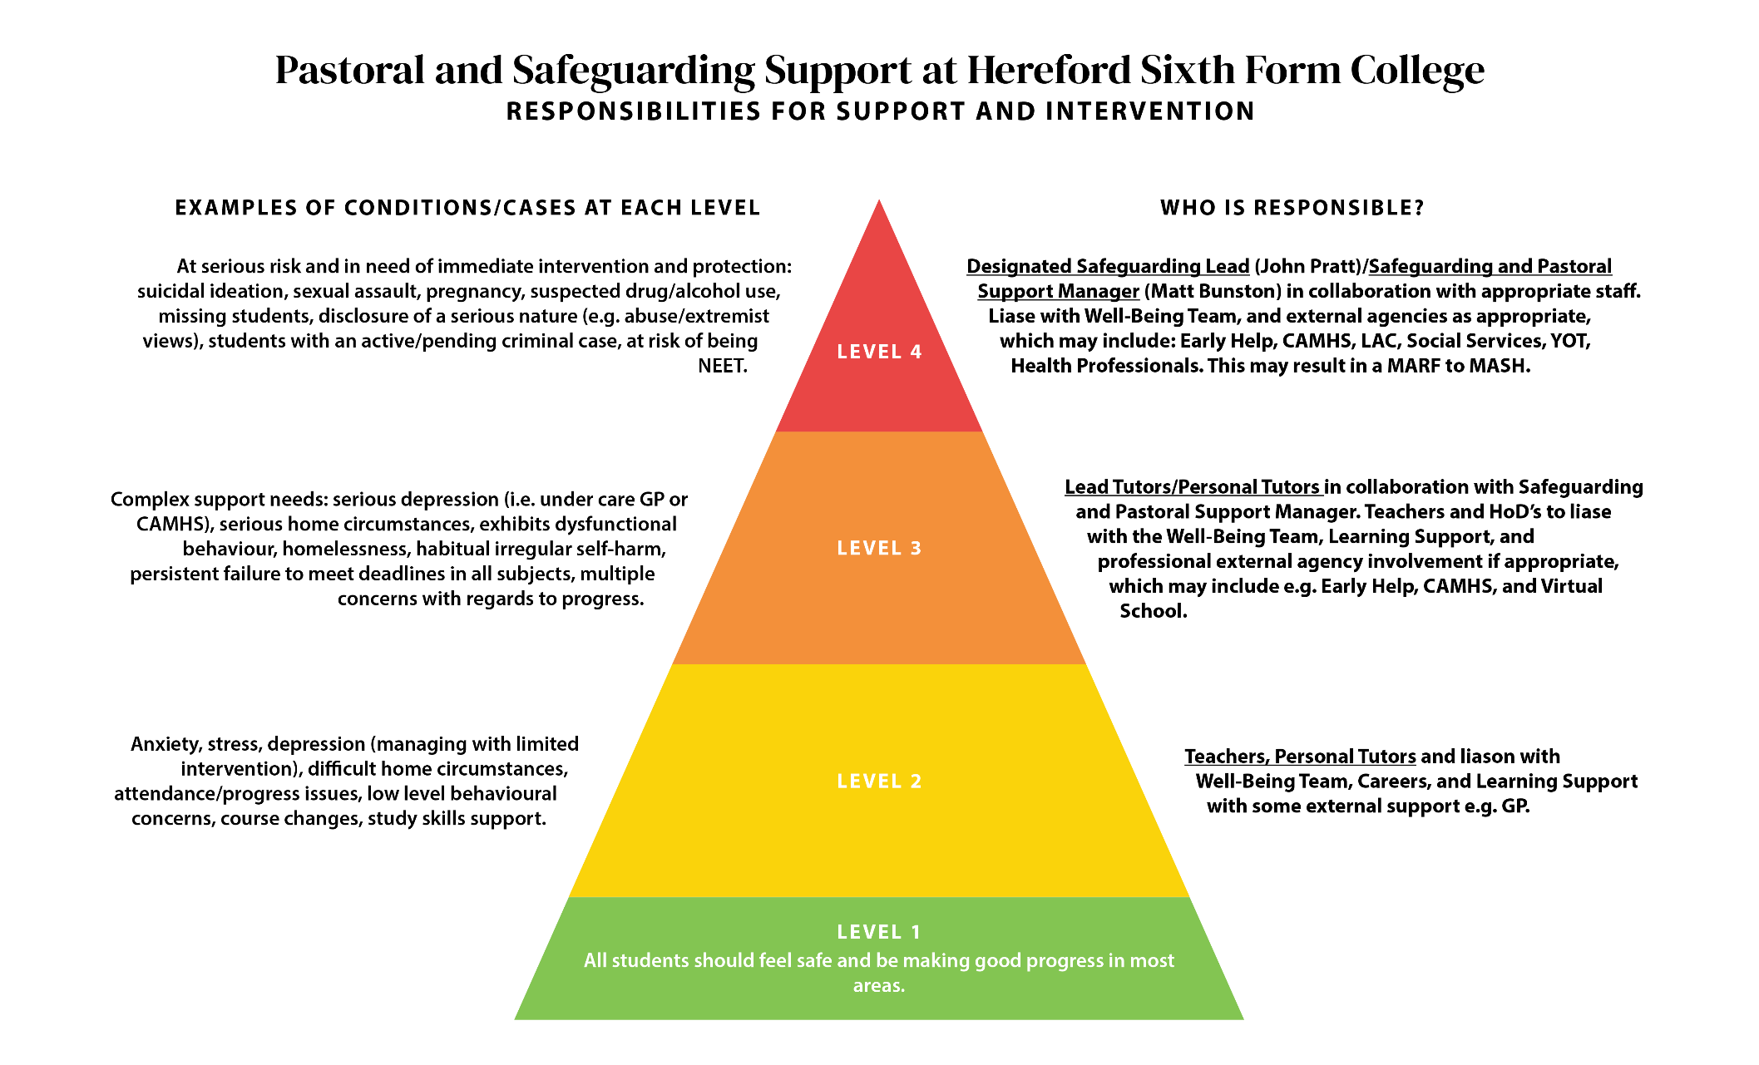

Slide 20

PARENTS
STUDENTS
STAFF

Slide 21
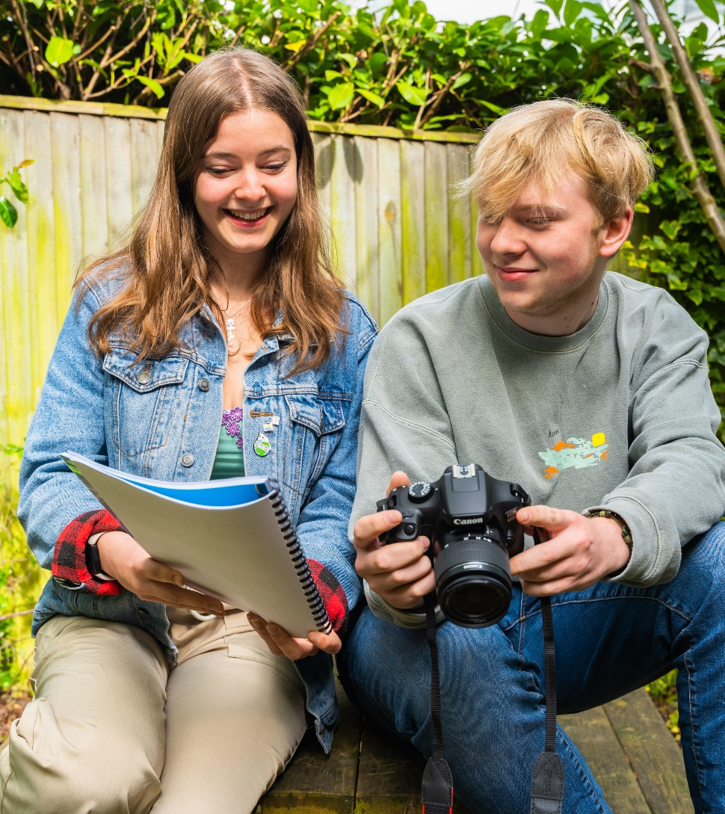
How does the partnership work with parents?
Progress and traffic lights
Timely reports
Parent Portal - students initiate sign up
Email or phone if issues arise
Work with the Personal Tutor
After December Formal Assessments there is an opportunity to see subject teachers in both years
Respond quickly

Slide 22
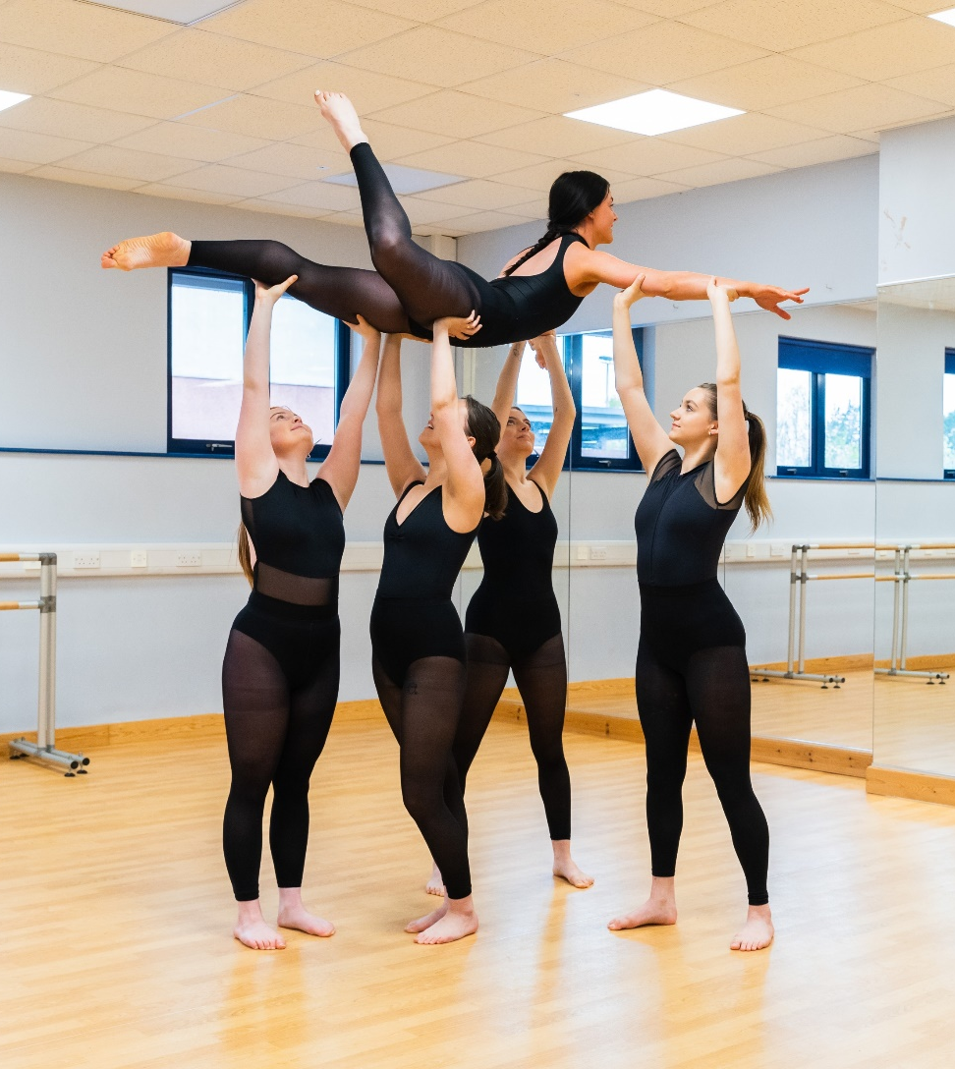
What can you do to help?
Encourage attendance
Be aware of college systems
Contact us if you feel there are any issues you wish to raise
Avoid arranging holidays in term time
Respond to requests for information
Help when students are ill or injured
Support the Impact programme

Slide 23
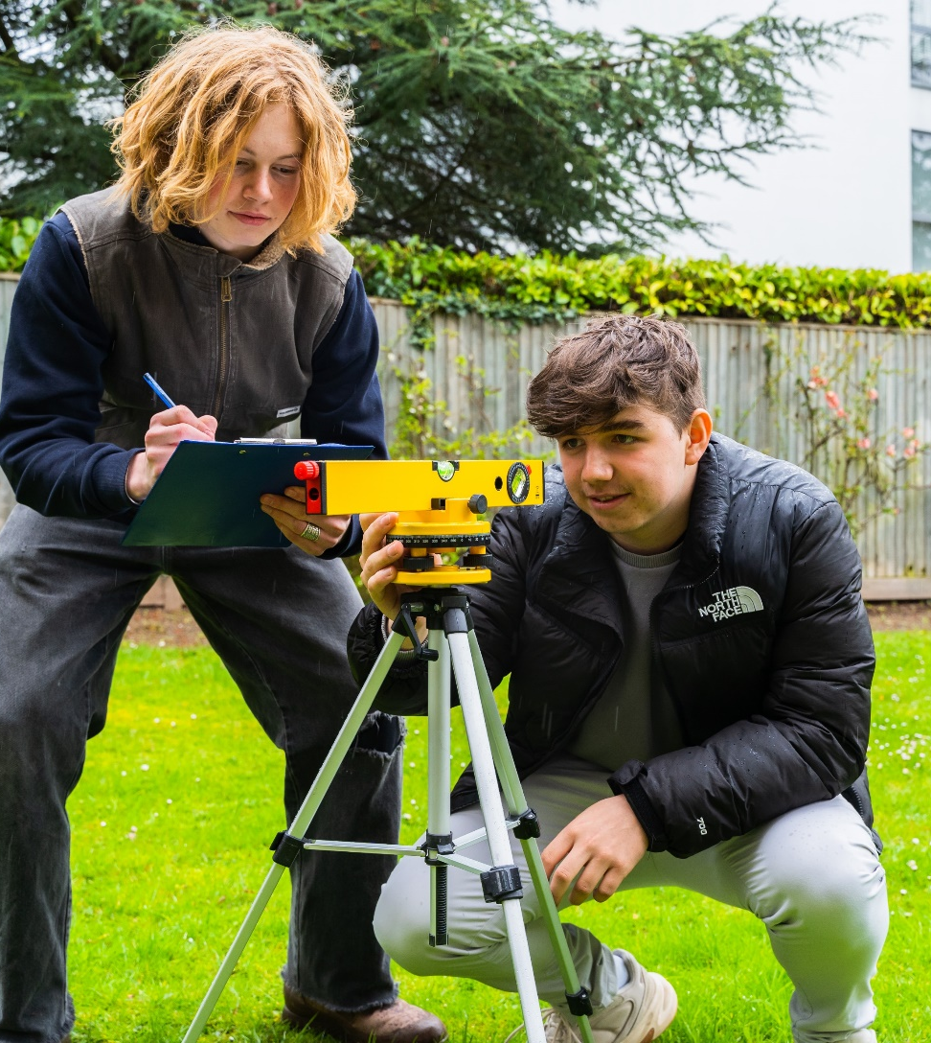
How can you help students in their time with us?
Encourage students to follow college procedures and regulations
Encourage them to engage with Learning Support if required (applications for access arrangements must be made in 1st year)
Discuss progress
Encourage students to talk to us about problems

Slide 24
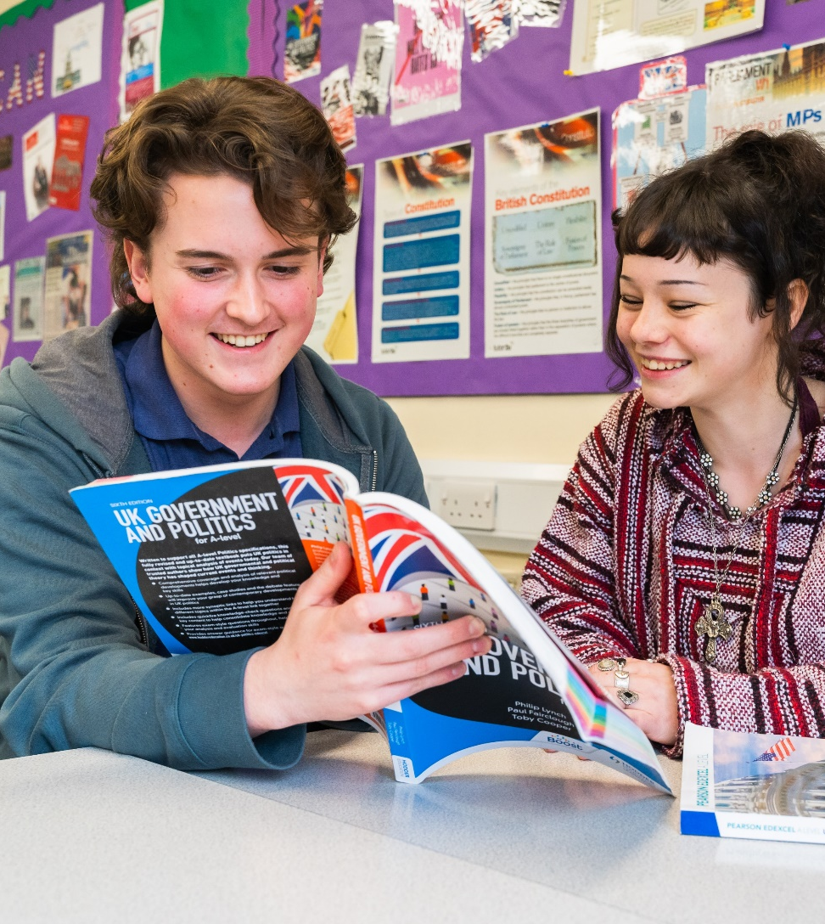
It can also be helpful to
Provide a suitable environment for study
Encourage a systematic approach to study
Limit part-time employment
Encourage regular routines which get enough sleep (for everyone!)

Slide 25
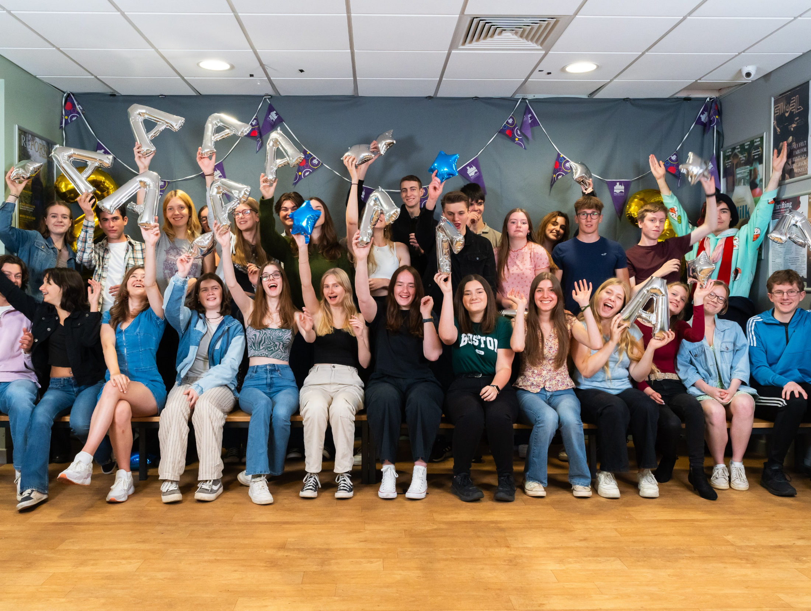
Thank you for making the time to join us and for choosing us.
We look forward to working with you.
Please email questions to
sixth-form@hereford.ac.uk

